Slide 7
Who likes Easter Eggs?

Slide 10
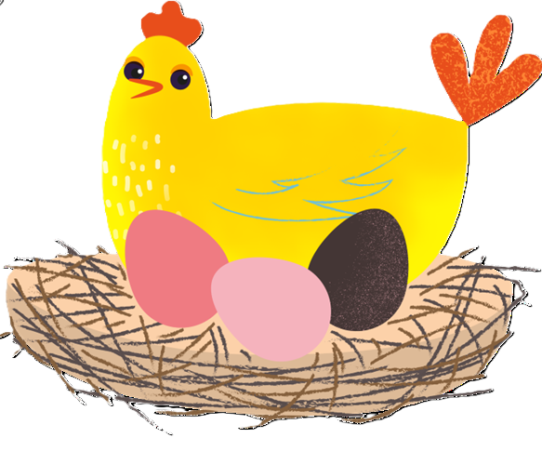
`

Slide 11
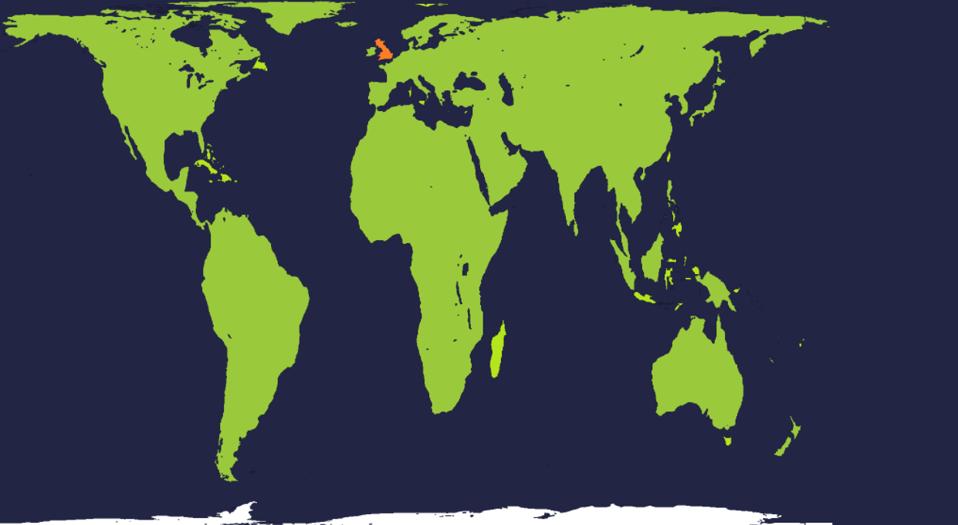
UK
Kenya
Catholic Social Teaching Link
Thinking of Everyone
(The Common Good)

Slide 12
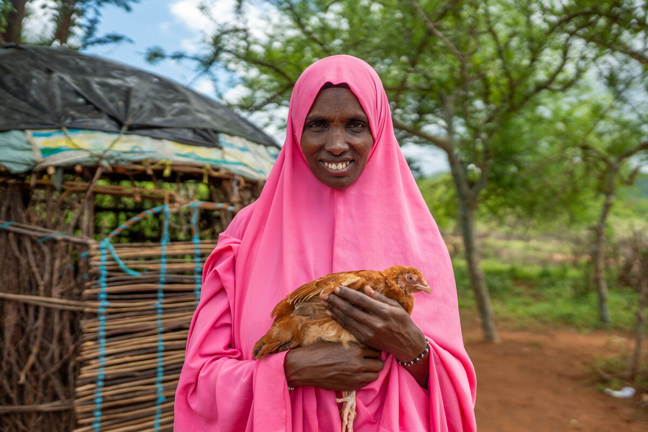
Khera

Slide 13
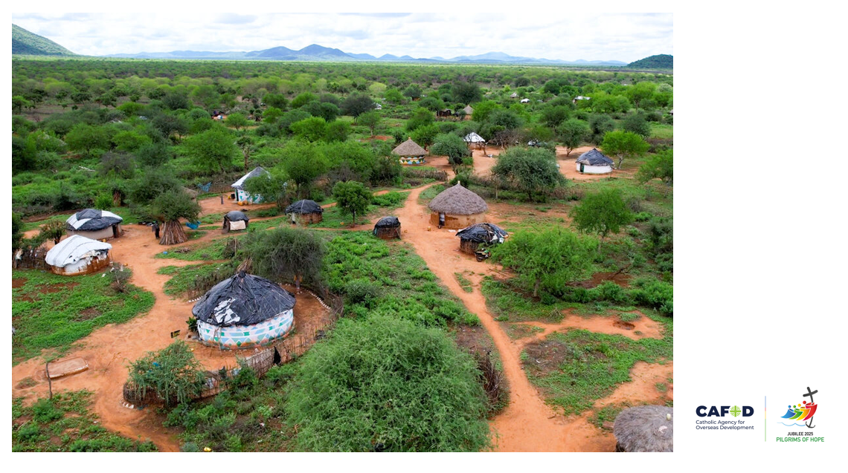

Slide 14
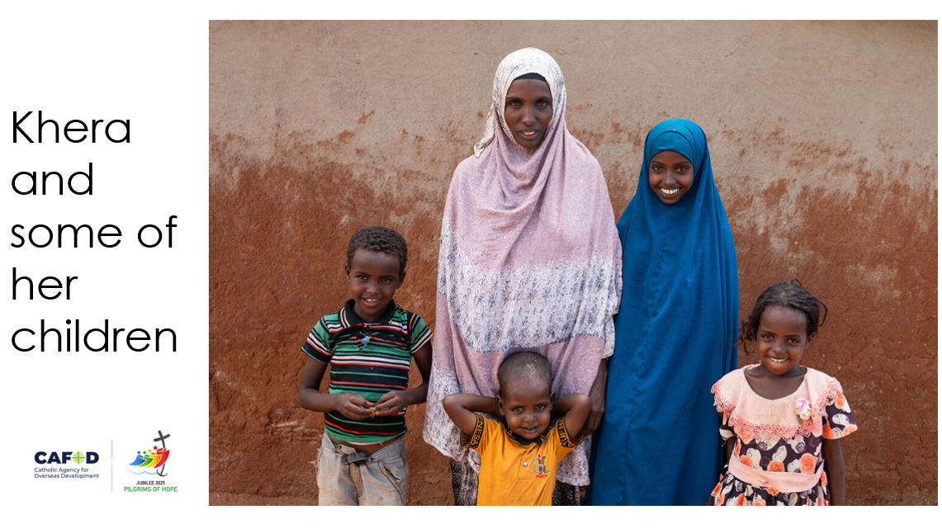

Slide 16
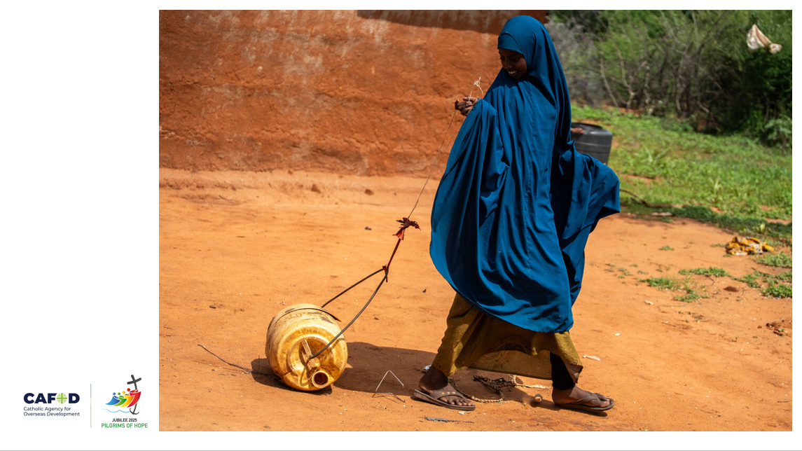

Slide 17
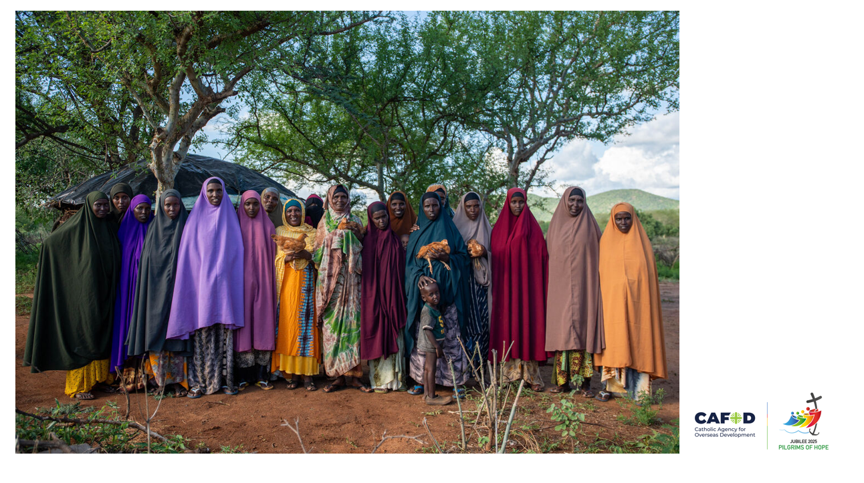
“Unity is strength. Let’s pull together to inspire. Let’s pull together to be strong.”
Khera

Slide 18
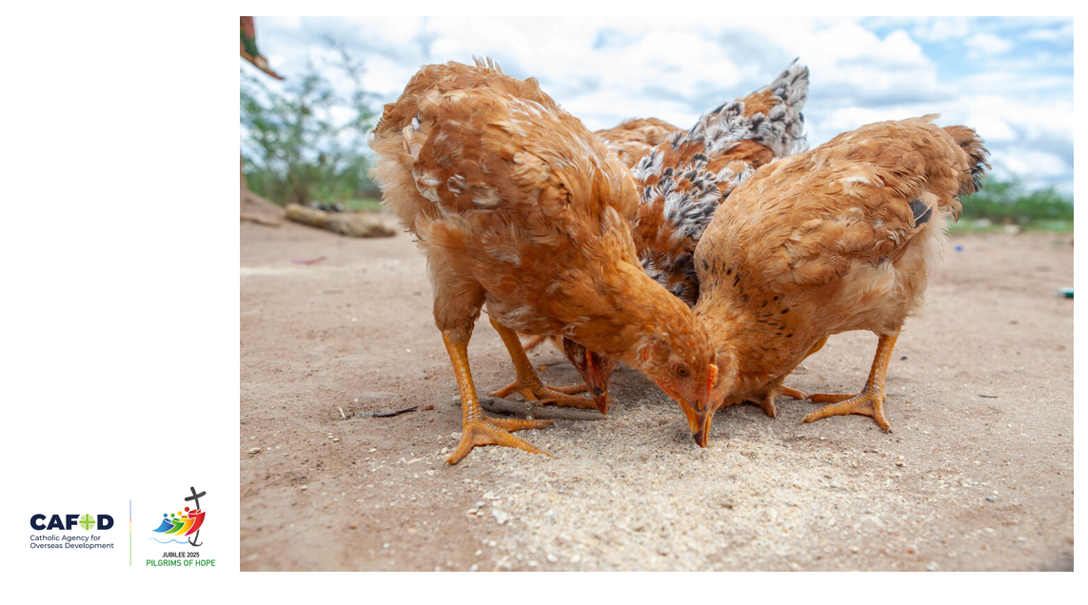

Slide 19
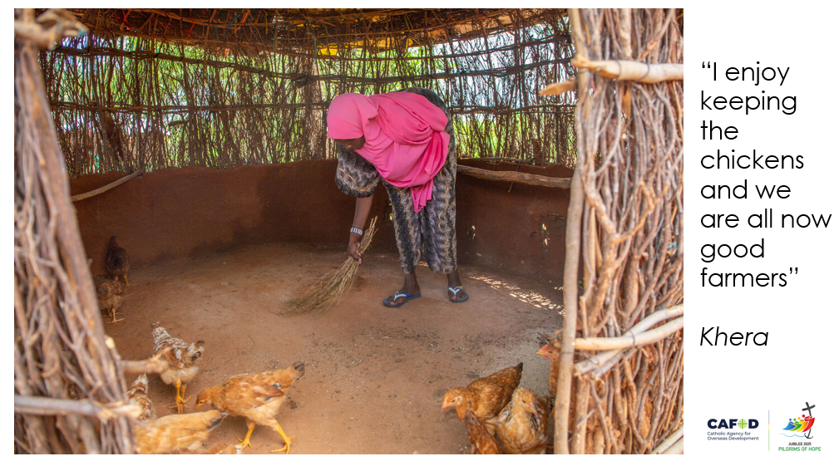

Slide 20
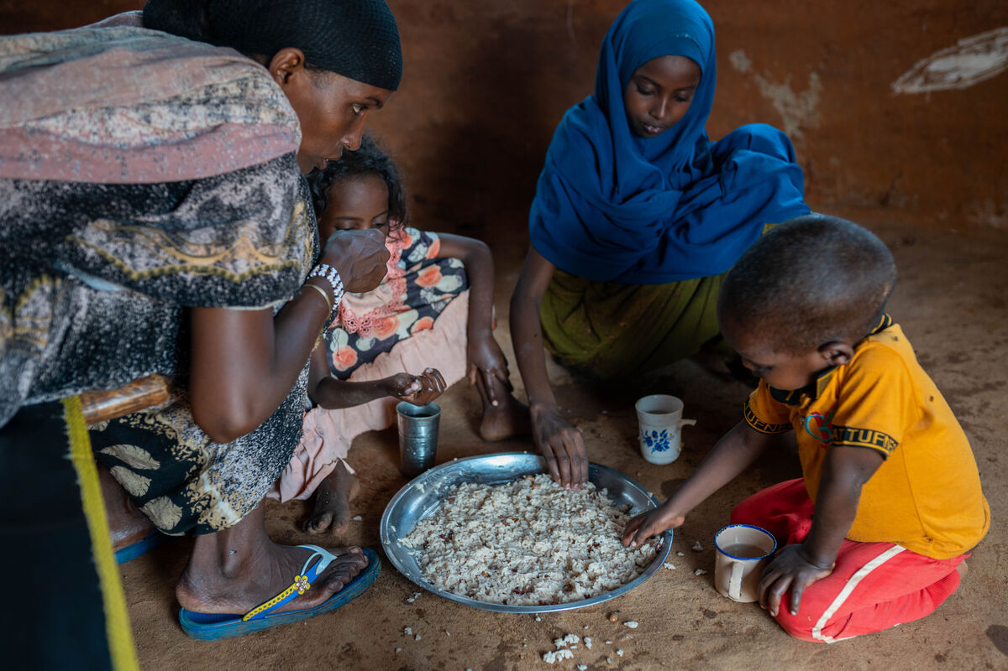

Slide 21
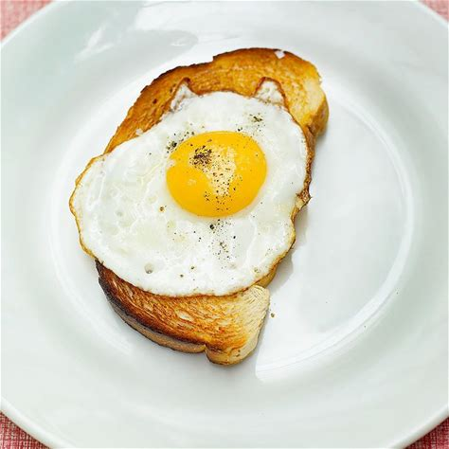
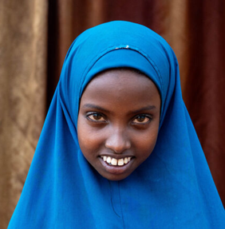
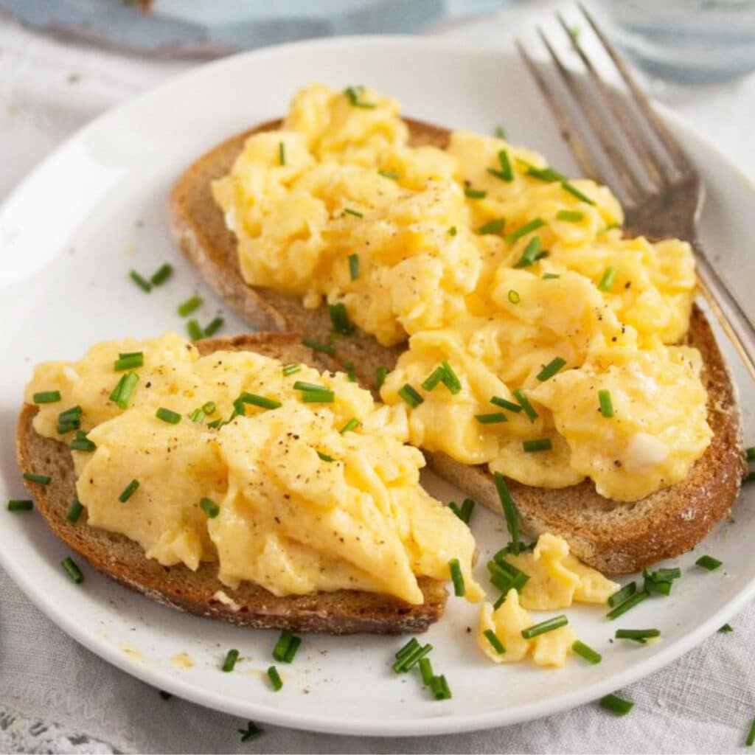
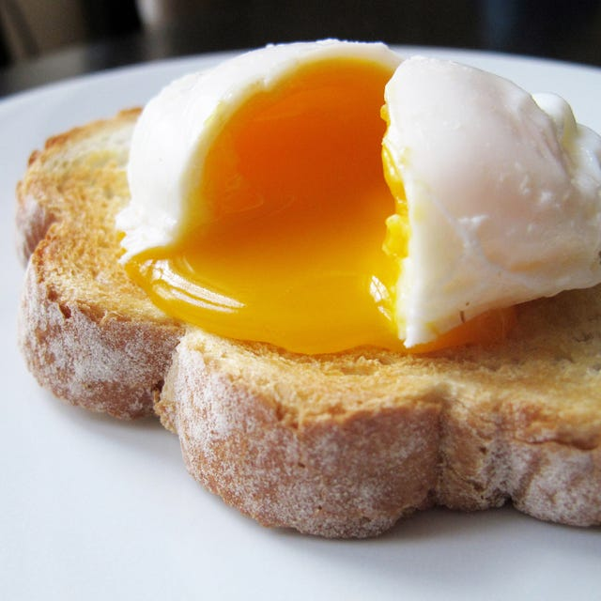
How does Chirri like to eat eggs
Boiled
Fried
?
Scrambled
Poached

Slide 22
How does Chirri like to eat eggs
Fried
“I want to have them fried for breakfast”

Slide 23
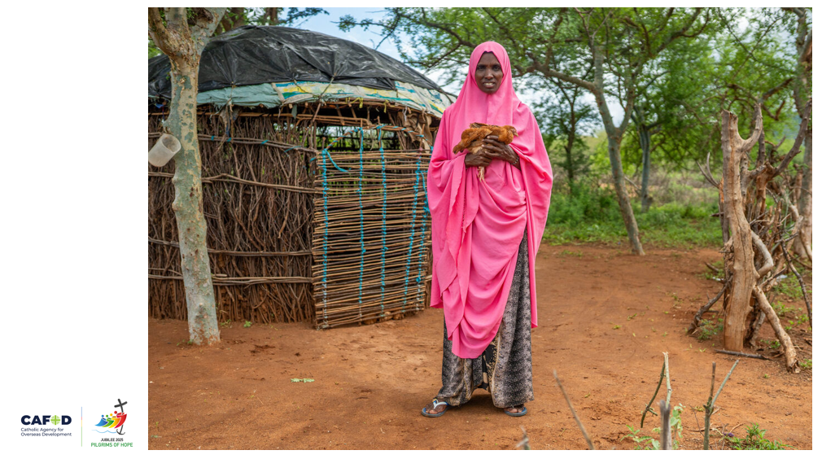

Slide 24
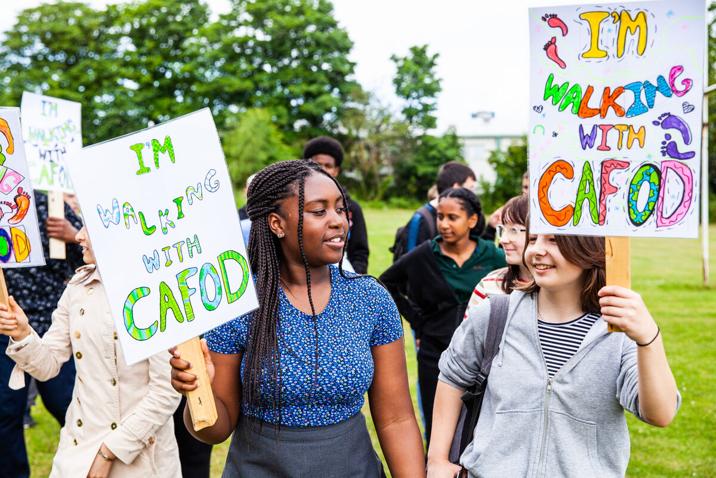
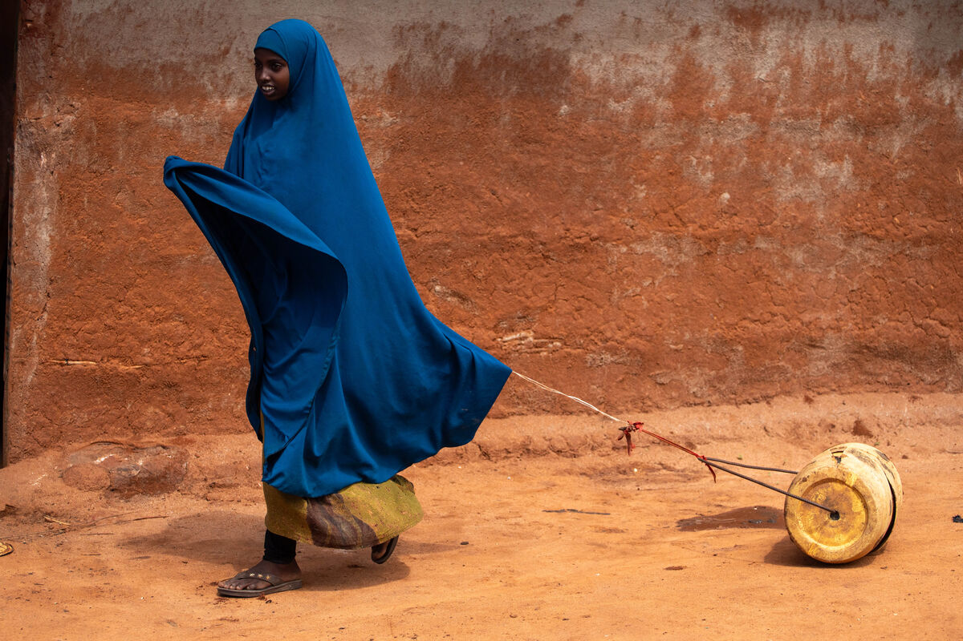
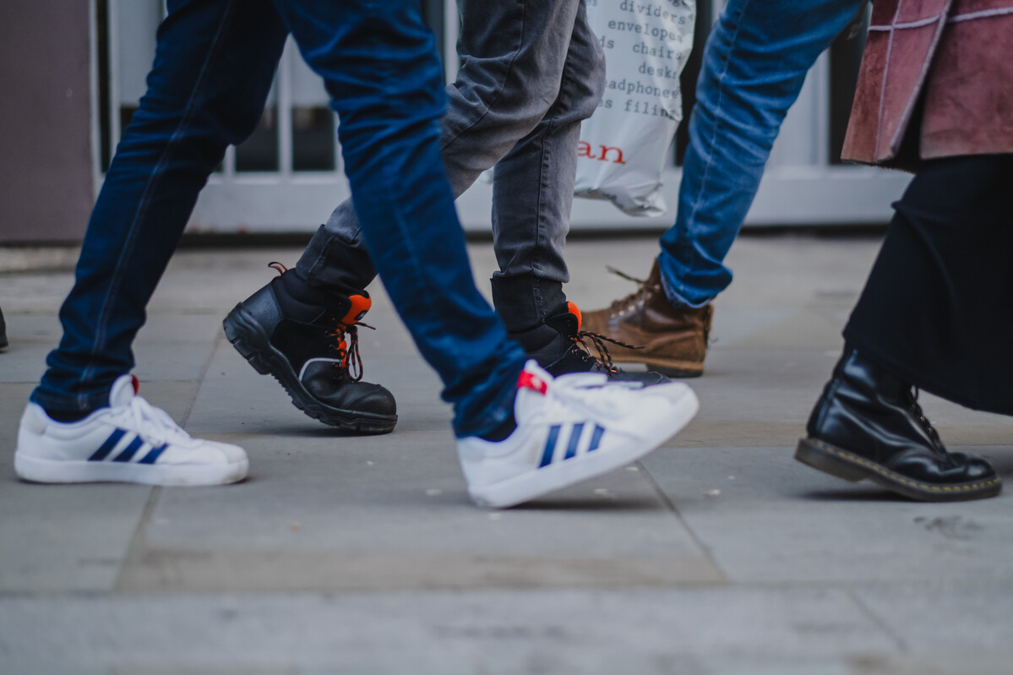

Slide 25
Each chicken costs £4.20

Slide 27
How many chickens could your school’s fundraising buy? y

Slide 28
Let us pray

Slide 29
God, our loving Father,
In this Jubilee year,
you remind us of our call to love creation.
Help us to work together
to replant, repair, and renew.
Guide us on our journey as pilgrims of hope.

Slide 30
Jesus, our light,
In this Jubilee year,
you remind us of our call to love our neighbours and to set free those who suffer.
Help us to treat everyone with dignity;
to be fair, forgiving and kind.
Guide us on our journey as pilgrims of hope.

Slide 31
Holy Spirit, our inspiration,
In this Jubilee year, you remind us of our call to grow in faith and love.
Help us to hear you in scripture, to see Jesus in others, and to be united as God’s global family.
Guide us on our journey as pilgrims of hope.
Amen

Slide 32
Thank you
Photo Credits: Thom Flint, Joe Newman, Alex Kamweru, Amit Rudro Bepar

