Slide 1
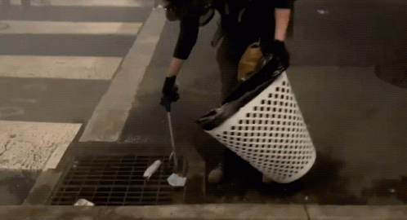
Live simply
Hi, i’m Jack and I’m going to introduce
You to our group and what we are going to talk about.Rayan is going to talk about pollution,litter and how it harms our environment.Anya and Benita will talk about how we can care for the world and Oliver will do the summary for you.

Slide 2
Litter,Pollution and how it harms the planet
Animals die every year because of litter,this is a huge problem for our wildlife which may fill their stomachs with plastics and other rubbish, instead of energy-rich foods they need to survive. Plastics and similar culprits may cause choking, airway or stomach obstruction and can ultimately lead to death.Air pollution is contamination of the indoor or outdoor environment by any chemical, physical or biological agent that modifies the atmosphere.

Slide 3
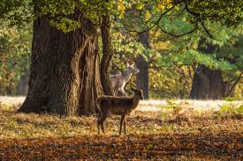
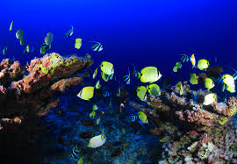
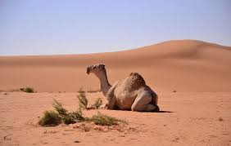
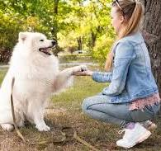
What you should do?
As christians we should help look after this world.Just like St Francis of Assisi.Pope Francis said “The Climate is a common good ,belonging to all .” This means that we must work together to care for our world. So what are we waiting for ? Let's make a start !

Slide 4
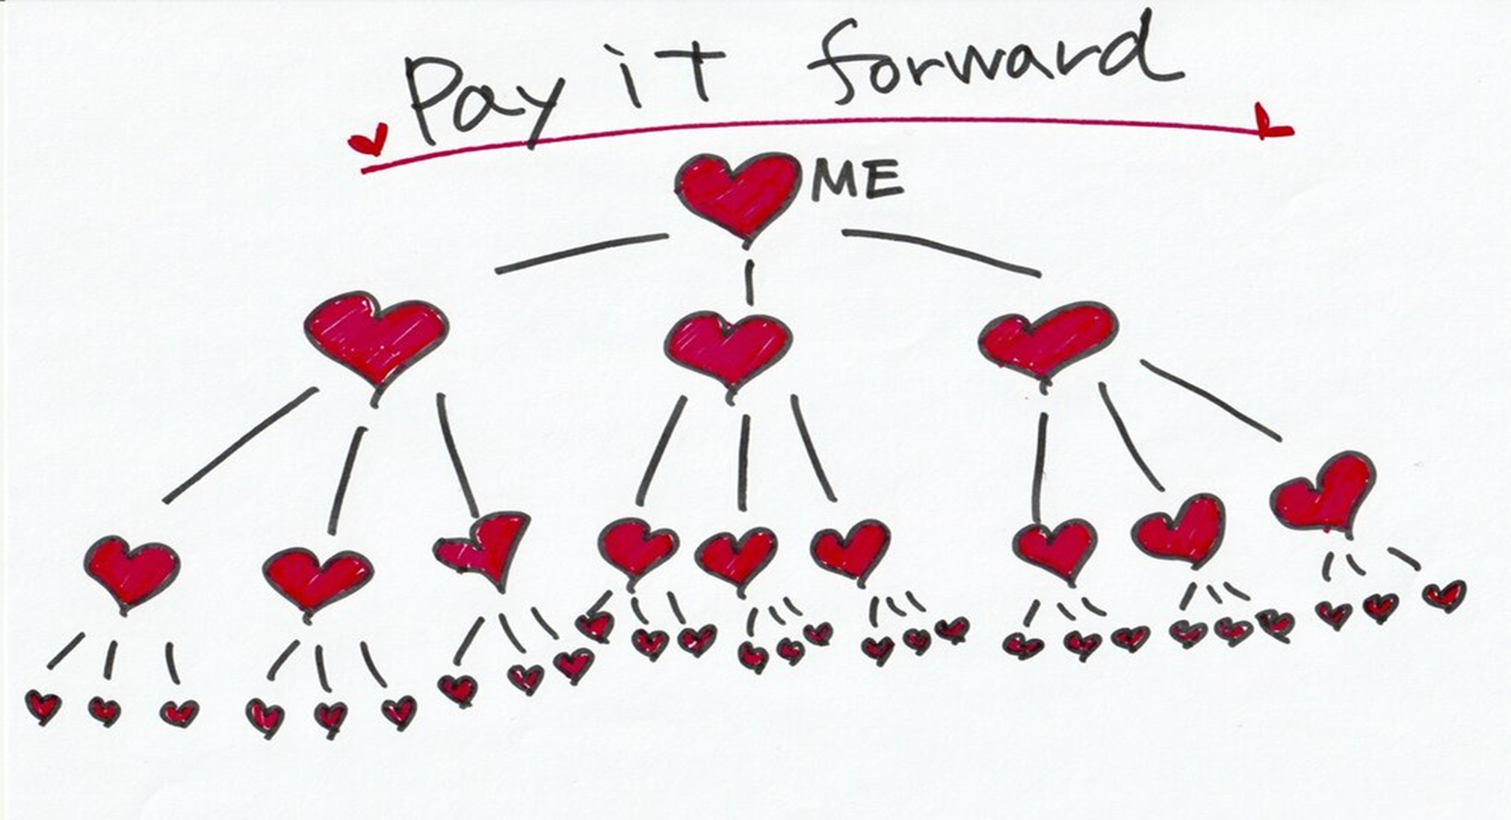

Slide 5
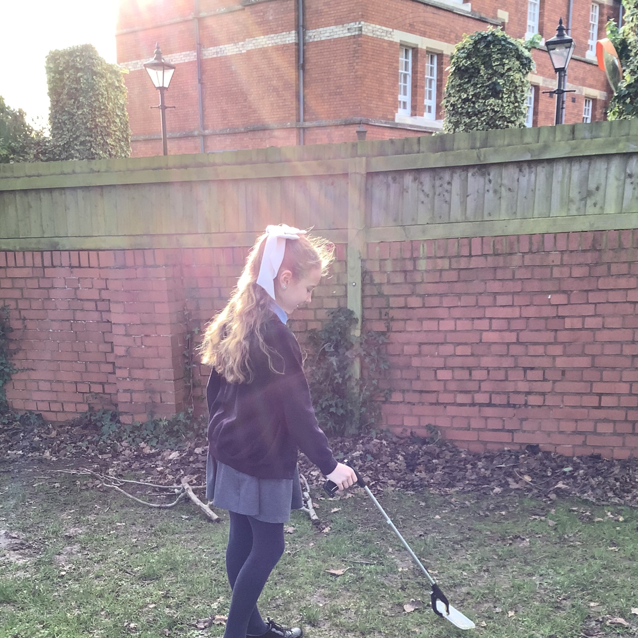
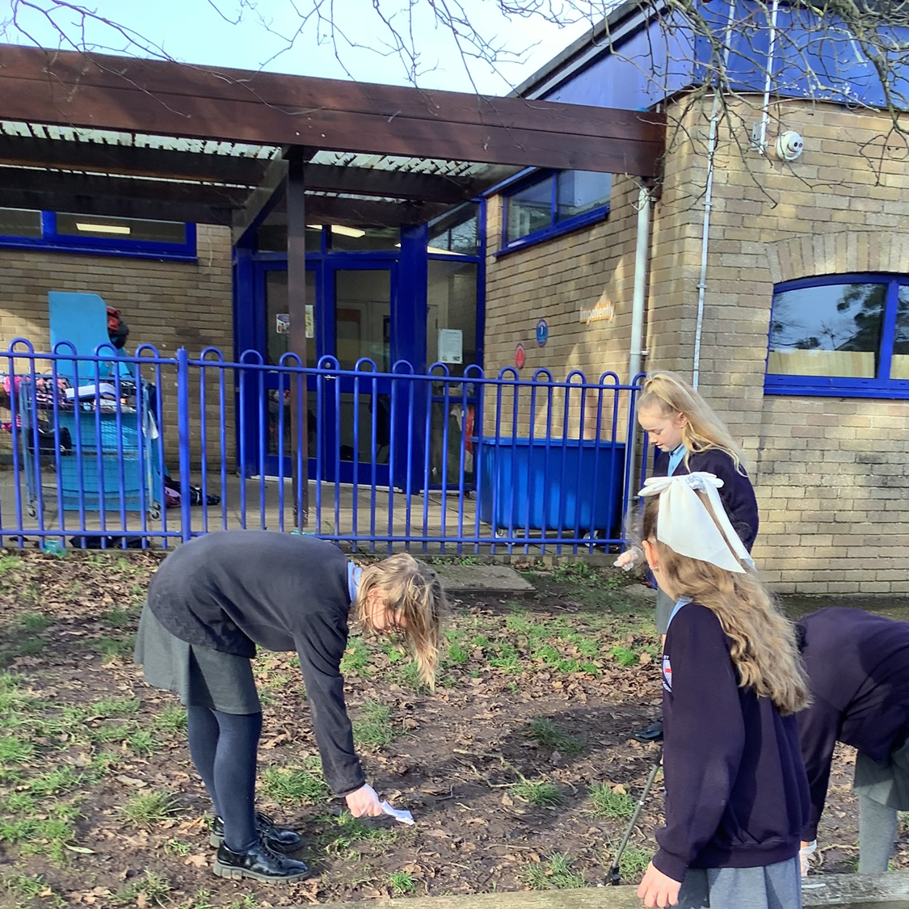
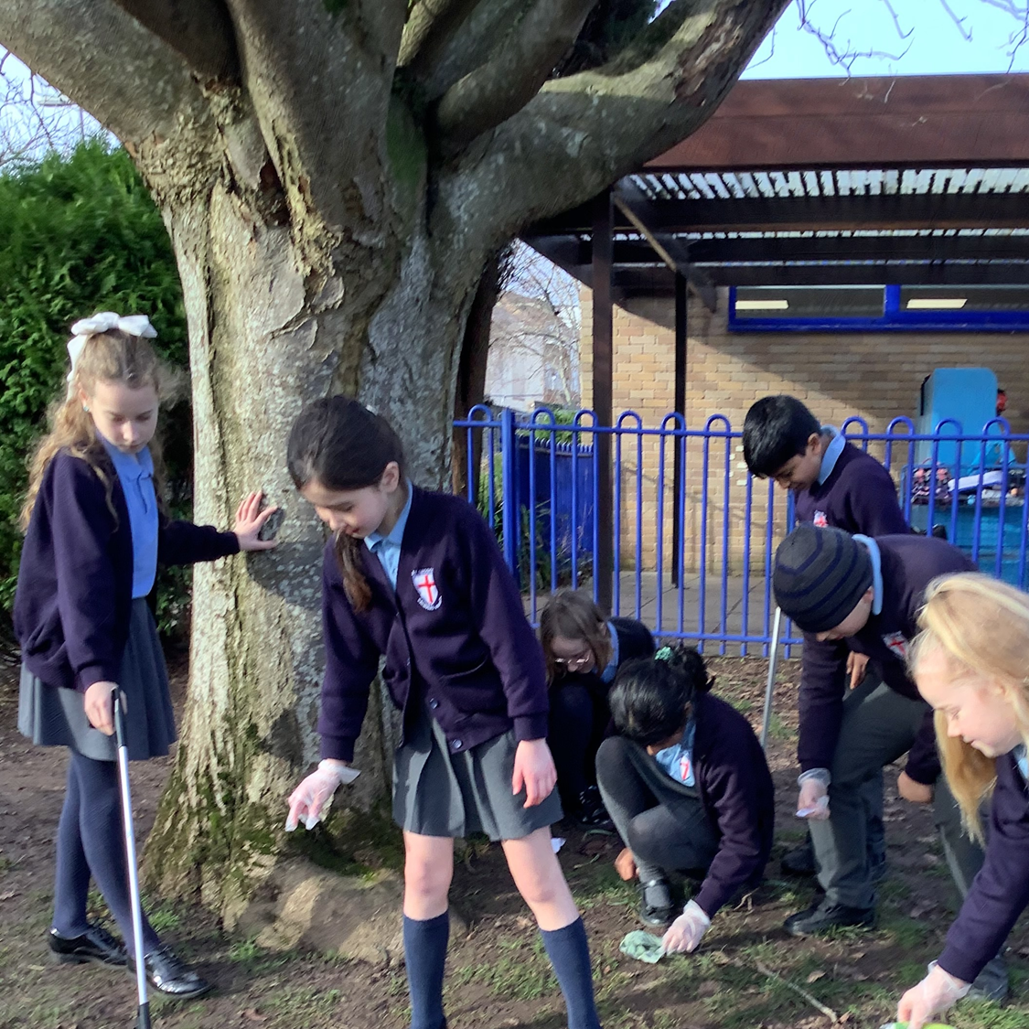

Slide 6
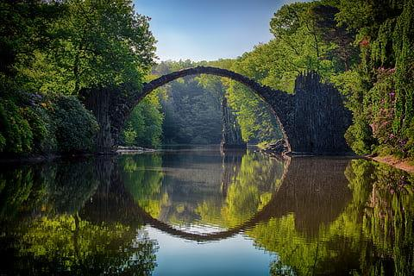
Threats to habitats and species
People on our world are damaging all habitats of animals leaving them homeless. Climate change is the main cause that harms this world.
Animals may try to cross highways and be hit by cars, or wonder into farmland or towns where they have to be killed in self defence as mankind have built towns to live in where animals used to live.

Slide 7
Endangered fish
Europe's biodiversity continues to be shaped by human activities. Pollution of air water and soil also impacts most habitats and species . Climate change leads to sea levels rising . Pollution doesn't just affect fish, it also affects corals too. Over the past century, habitat loss has been the most common cause of extinction for fish in the United States.Did you know NOAA Fisheries has jurisdiction over 165 endangered and threatened marine species ( 80 endangered , 85 threatened )?

Slide 8
Rubbish and Pollution
Did you know? People tend to get in car accidents trying to avoid litter on the road. Another consequence of littering is that many animals get wounded and cut by wrongly disposed glass. Litter and pollution intoxicates our plants that we eat, this can intoxicate our bodies!

Slide 9
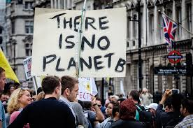
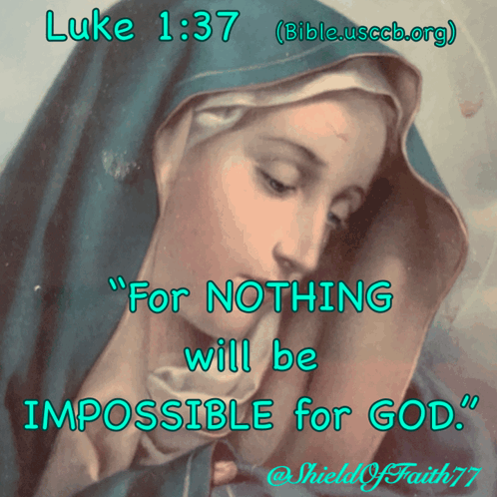
What should us Christians do?
As Christians, we should take action like Jesus would and spread the word. We must think of the other, poorer people in our global family

Slide 10
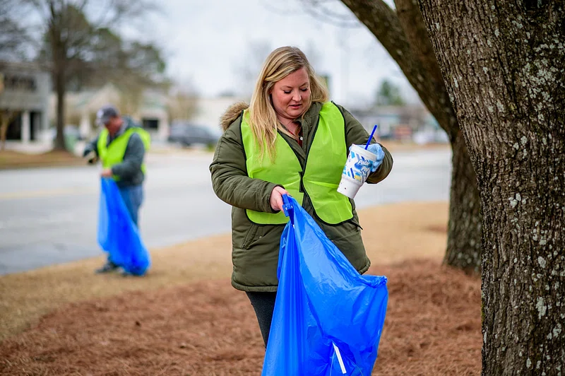
How can we help?
We can put waste in the right bins, litter pick, clean land and sea, not litter and not use plastic. We must start NOW.

Slide 11
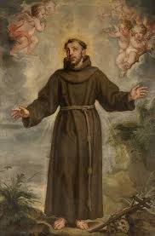
Let us say in the name of the Father, the Son and the Holy Spirit
Dear St. Francis of Assisi
Help us to care for the world and for other people. Support us on the journey we have to take for a better, safer and cleaner world!
AMEN

