Slide 1
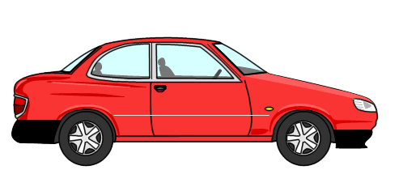

accidental
accidentally
accident
My car got a dent in the accident.

Slide 2
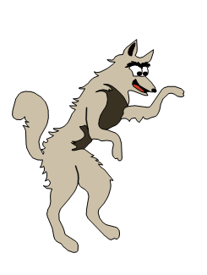
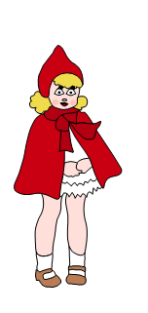
actually
actual
Actually, most wolves prefer the taste of fresh rabbit.
In actual fact, big bad wolves are usually just big softies.

Slide 3
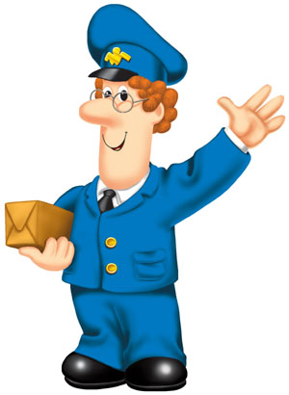
address
Be sure to add the address before you post it!

Slide 4
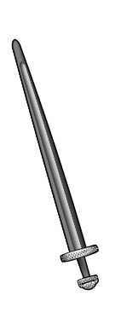
answer
Can you think of another word where only the s part of sw is sounded?
Hint:

Slide 5
appear
To make it disappear, just add dis.

Slide 6

arriving
arrival
arrive
arrived

Slide 7
believe
I believe
that...
It is my belief
that...
What other words follow the rule: i before e except after c when making the ‘ee’ sound?

Slide 8
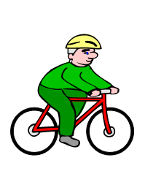
bi = two
cycle = circle
bicycle
Do you know what these other ‘bi-’ words refer to?
biceps biped bisect bivalve binoculars

Slide 9
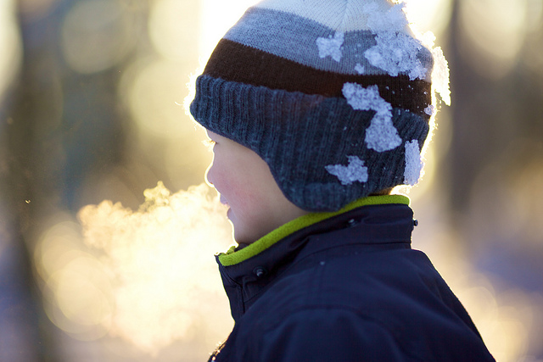
breath
On a cold day we can see our breath.

Slide 10
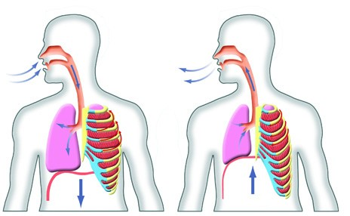
breathe
Take a deep breath and breathe slowly.

Slide 11
build
build
build
build
build
build
build
build
builder
building

Slide 12
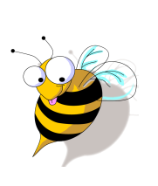
busy
busy
business

Slide 13
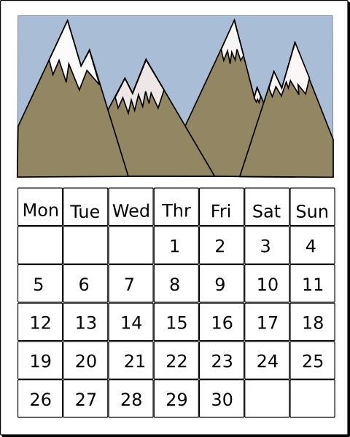
calendar
Mark the date on the calendar.

Slide 14
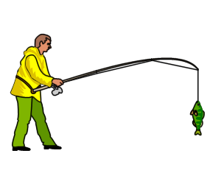
caught
catch
caught

Slide 15
centre
What other words can you think of that start with ‘ce’?
Fact: ‘ce’ is nearly always soft!

Slide 16
100 years = a century
100 runs = a century
century
cent - - - - hundred
Can you think of any words that start with ‘cent’ that have that hundred connection?

Slide 17
certain
Remember – ce usually softens the c, but cu is a hard c, so...
You can be certain it’s not a curtain.

Slide 18
circle
circle
Did you know that circle and circus come from the same Latin root?
Fact: ‘ci’ is nearly always soft! What other words start with ‘ci’?

Slide 19
complete
Complete can be an adjective or a verb.
Can you make a sentence using complete as an adjective?
Can you make a sentence using complete as a verb?

Slide 20
considering
consideration
consider
considerable
considered

Slide 21
continuing
continued
continue
continues
continuation

Slide 22
decide
deciding decided decision

Slide 23
describe
description
describe
prescribe
prescription
subscribe
subscription

Slide 24
different
Things are different if they differ.

Slide 25
challenging
tricky
difficult
hard
arduous
onerous
problematic

Slide 26

early
earlier
earliest
The ear in early makes an /ur/ sound.
What other words do you know where ear makes that sound?
Can you think of any words where the ear doesn’t make an /ur/ sound?

Slide 27

earth
earth
Earth

Slide 28

eight
eighth

Slide 29
enough
Enough has the ‘ough’ string making an ‘uff’ sound.
Can you think of any other words containing ‘ough’ that make the same sound?

Slide 30
exercise

Slide 31
experience
Can you make up a sentence using experience as a noun?
Can you make up a sentence using experience as a verb?

Slide 32
experiment
Can you make up a sentence using experiment as a noun?
Can you make up a sentence using experiment as a verb?

Slide 33
extreme
Extreme sports can be extremely exciting!

Slide 34
famous

Slide 35

favourite
We always choose our favourite ice-cream.

Slide 36
February
Feb
ru
ary

Slide 37

forwards
forwards

Slide 38
fruit
Juicy fruit bruises easily.

Slide 39
grammar
You want only ‘A’s in grammar.

Slide 40
group
Can you think of other words which have ‘ou’ making the /ue/ sound?

Slide 41
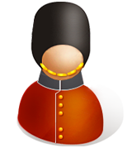
guard
The ‘u’ in guard is silent.
Can you think of any other words that begin ‘gu’ where the ‘u’ is silent?

Slide 42
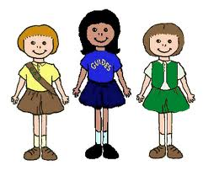
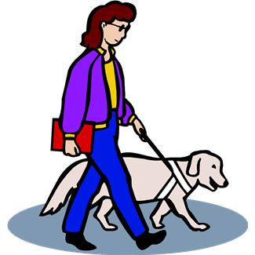
guide
Can you think of examples where guide can be used as a noun? A verb? An adjective?

Slide 43
heard
Remember: Heard is the past tense of hear, and you hear with your ear.
Note: Although it contains the ear string, the ear in heard is sounded as /ur/.

Slide 44
heart
Notice that the ear string is sounded as /ar/ in the word heart.
How is it sounded in heard? How is it sounded in beard?

Slide 45
height
BEWARE! High... but... height.

Slide 46
history
Remember that historical comes from history, so that will remind you not to miss out the ‘o’ in history.

Slide 47
imagine
imagination

Slide 48
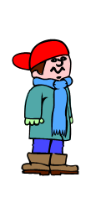
increase
Noun or verb?
Alex hoped Dad would increase his pocket money.
He was hoping for an increase of 50p.

Slide 49

important
important importance

Slide 50
interest
interested
interesting
uninteresting

Slide 51
island
An island is land surrounded by water.

Slide 52
knowledge
Having knowledge means that you know a lot.

Slide 53
learn
The more you learn, the more you can earn!

Slide 54
length
Remember:
The words length and long share the same root,
so don’t forget the ‘g’.

Slide 55

library
Helpful hint:
A librarian works in a library

Slide 56
material

Slide 57
medicine
medical
medicinal
paramedic

Slide 58
mention
... not to mention...
... worth a mention ...
... don’t mention it...
... and a special mention
for...

Slide 59
minute
1 minute = 60 seconds
minute = very small
One spelling - two different meanings with two different pronunciations

Slide 60
natural
Root: nature
Opposite: unnatural
Associated words: naturalist naturally

Slide 61
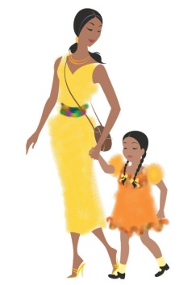
naughty
Can you think of any other words that contain
the ‘aught’ string?
Here’s a clue for one...

Slide 62

notice
“Did you notice the notice?”
Same spelling, different meanings.

Slide 63
occasion
occasional
occasionally

Slide 64
usually
repeatedly
regularly
often
generally
frequently
as a rule

Slide 65
opposite
If you oppose someone, you take the opposite point of view.

Slide 66
ordinary
Think of the word ordinarily – it will help you remember the unstressed vowels.
Did you know that the word extraordinary means
‘out of the ordinary’?

Slide 67
worthy of special attention
concerned with detail
distinct
singular
fussy
particular
Fact: Particular comes from the same root as particle.
Tricky word: Particularly - easy, just add -ly

Slide 68
specific
idiosyncratic
strange
distinctive
eccentric
odd
peculiar
Tricky word: Peculiarity – just add -ity

Slide 69
maybe
for all one knows
perchance
perhaps
mayhap
possibly
peradventure

Slide 70

popular
Think of the word popularity– it will help you remember the unstressed vowels in popular

Slide 71
position
Its root word means ‘place’, but position can be
used in various contexts.
How can it be used to describe a location? A job?
A stance in an argument?
How could it be used as a verb?

Slide 72

possess
possession
possesses
possessed

Slide 73


possible
im
possible
possibility impossibility

Slide 74
potato
potatoes
Only the plural (potatoes) has an –e in the word.

Slide 75
pressure
Pressure presses on an object.
pressure cooker

Slide 76
probably
probable
probability
improbable

Slide 77
promise

Slide 78
purpose
Be aware of the unusual ending.
Not to be confused with the command for a cat to cheer up!
(Purr, puss. Get it?)

Slide 79
quarter
quarter
quarter
quarter
quarter

Slide 80

question
questioned questionable

Slide 81
recent
recently
Remember: ‘ce’ usually makes the /s/ sound.

Slide 82
regular
Adverb: regularly
Opposite: irregular

Slide 83
reign
HOMOPHONES
reign rain rein

Slide 84
remember
“Remember, remember, the fifth of November.”

Slide 85

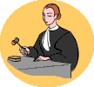
sentence
The word sentence has two distinct meanings.
Do you know what they are?

Slide 86
separate
Never separate a para from his parachute!

Slide 87
special
The CIA employ special agents.

Slide 88
straight
straight

Slide 89
strange
stranger
strangely
strangeness

Slide 90
strength
Strong and strength come from the same root, so don’t forget the ‘g’.
When you strengthen something you make it stronger.

Slide 91
suppose
supposes
supposed
supposing

Slide 92
surprise
surprised surprisingly unsurprisingly

Slide 93
for that reason
therefore
consequently
Don’t forget the final ‘e’.

Slide 94
though
although
Can you think of any other words where the ‘ough’ string makes the /oe/ sound?

Slide 95
thought
Can you think of any other
words where the ‘ough’ string
makes the /au/ sound?

Slide 96
through
Homophones
threw through
He threw the ball through the open window.

Slide 97
various
vary
variety
variably
variable

Slide 98

weight
The weight of the box was eight kilograms.
Homophones: wait - weight

Slide 99
woman
One woman; several women.

