Slide 1



WHO is in the picture?

Slide 2

Celebration of the word
for primary schools
Jubilee
Pledge

Slide 3
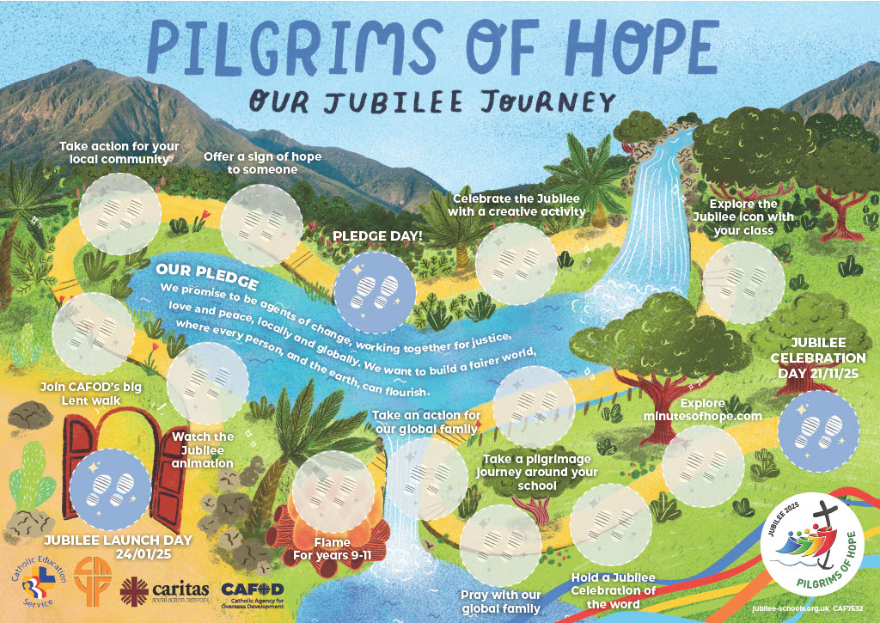



Slide 4
Gather and connect:
Where in the school has Mrs Earp tried to recreate this poster?
What is this special year called?
What are we?

Slide 5


Slide 6
Connect :
Could you recognise lots of the things that we have already done in the video? Talk to your partner about some of the things that we have done so far on our Jubilee Year.
We still have lots to do !
Who can tell me what they know they still have planned for the Jubilee Year ?

Slide 7
Let us think again about why we are having a Jubilee Year. What scripture has inspired this?
Let’s look at the Jubilee Icon.
James is going to read the scripture for us.

Slide 8
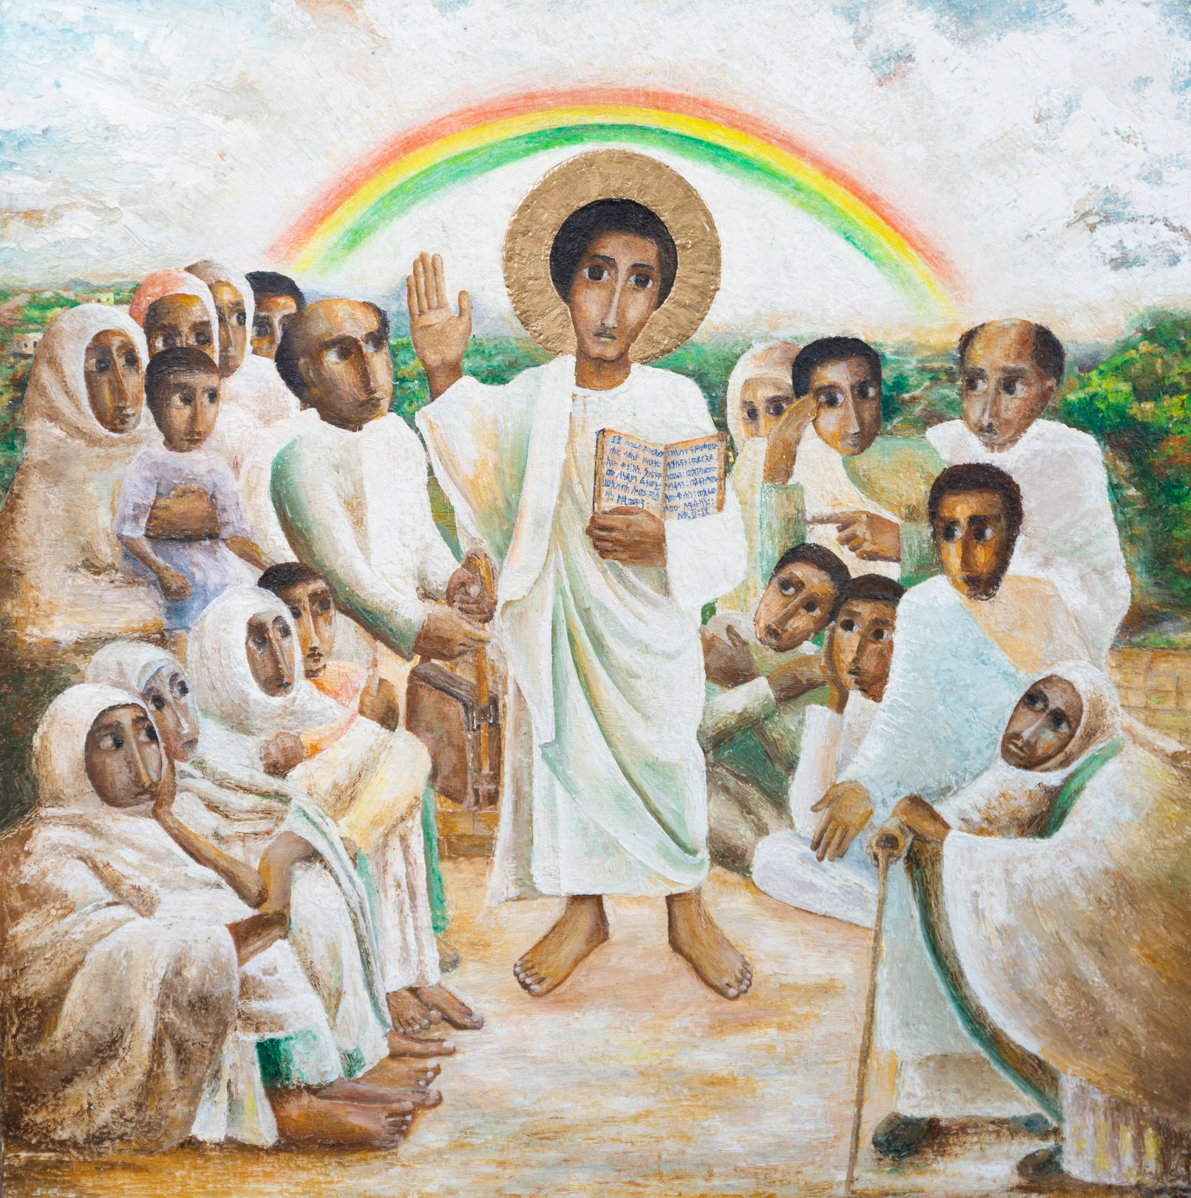


“The Spirit of the Lord is upon me,
because he has chosen me to bring good news to the poor.
He has sent me to proclaim
liberty to the captives
and recovery of sight to the blind,
to set free the oppressed
and announce that the time has come when the Lord will save his people.”
Word

Slide 9

As Jesus finishes teaching, and rolls the scroll away, he declares that he has come to fulfill Scripture.
I invite you now to sit quietly and look carefully at the icon.
What draws you in?
What thoughts or feelings does the icon bring
up for you about Jubilee?
Respond

Slide 10

WHO is in the picture?

Slide 11

The Chaplains will deliver a copy of the icon for display in your classroom and some notes for you, your teachers and families to reflect upon quietly in class before the end of the day. Use the icon to remind you of why we are on this Jubilee Journey.
.
Send

Slide 12



The Jubilee Pledge
We are pilgrims of hope.
We walk in solidarity with our sisters and brothers worldwide, sharing challenges and celebrating joys.
We promise to be agents of change, working together for
justice, love and peace, locally and globally.
We want to build a fairer world, where every person, and the earth, can flourish.
WHO is in the picture?
Everyone should have what they need to live life to the full!

Slide 13
Catholic Social Teaching – the pledge in action!
We recognise the dignity of every person, loved and created by God.
We follow the example of Jesus’ love and his mission to bring good news ‘to the poor’. (Luke 4)
We work for the common good of all, understanding that our actions impact our local and global family because we are all interconnected.
We are good stewards of the earth, knowing that the earth’s gifts are for everyone, not just for a privileged few.
We prepare a path to peace in our world, challenging the root causes of poverty and injustice.
We speak out for debt relief, to set free those who are burdened by unjust debt.
We work together with CAFOD and our local Caritas to be
practical signs of hope and put love into action.
WHO is in the picture?

Slide 14

WHO is in the picture?

Slide 15
We are one step ahead and we already made our pledges on our Disconnect to Reconnect Day.
Our Chaplains will read some of them to you
.
Send

Slide 16
Who has already started working on their pledge?
Who has great plans for their pledge?
Talk to your partner.
At playtime , I will be out in the playground. If you want to tell me all about your pledge , you can come and find me.
.
Send

Slide 17
How amazing you are!
Now, our Chaplains will lead us in prayer so we can send our hopes to God. With all the hard work we have planned, we may need God’s help.
.
Send

Slide 18
A prayer of hope
God, our loving Father,
In this Jubilee year,
you remind us of our call to love creation.
Help us to work together
to replant, repair and renew.
All: Guide us on our journey as pilgrims of hope.
Send

Slide 19
Jesus, our light,
In this Jubilee year,
you remind us of our call to love
our neighbours
and to set free those who suffer.
Help us to treat everyone with dignity;
to be fair, forgiving and kind.
All: Guide us on our journey as pilgrims of hope.
Send

Slide 20
Holy Spirit, our inspiration,
In this Jubilee year,
you remind us of our call to grow in faith and love.
Help us to hear you in scripture, to see Jesus in others,
and to be united as God’s global family.
All: Guide us on our journey as pilgrims of hope.
Send

Slide 21

Send

Slide 22
Now let us sing:
Christ Be Our Light
Longing for light, we wait in darkness
Longing for truth, we turn to You
Make us Your own, Your holy people
Light for the world to see
Christ, be our light
Shine in our hearts
Shine through the darkness
Christ, be our light
Shine in Your church gathered today
Send

Slide 23
Longing for shelter, many are homeless
Longing for warmth, many are cold
Make us Your building, sheltering others
Walls made of living stone
Christ, be our light
Shine in our hearts
Shine through the darkness
Christ, be our light
Shine in Your church gathered today
Send

Slide 24
Many the gifts, many the people
Many the hearts that yearn to belong
Let us be servants to one another
Making Your kingdom come
Christ, be our light
Shine in our hearts
Shine through the darkness
Christ, be our light
Shine in Your church gathered today
Send

Slide 25
As you leave , take a close look at the icon and take some time to think about how it will impact your day. Remember your pledge. Could today be a day to work on it?
When you get back to class find and shake of your CAFOD box. How full is it? Could you use this halfway point in the Jubilee Year to donate?
Send

Slide 26
WHO is in the picture?

