Slide 1
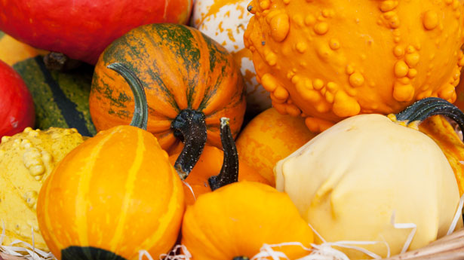
Harvest Rap
Class 3

Slide 2
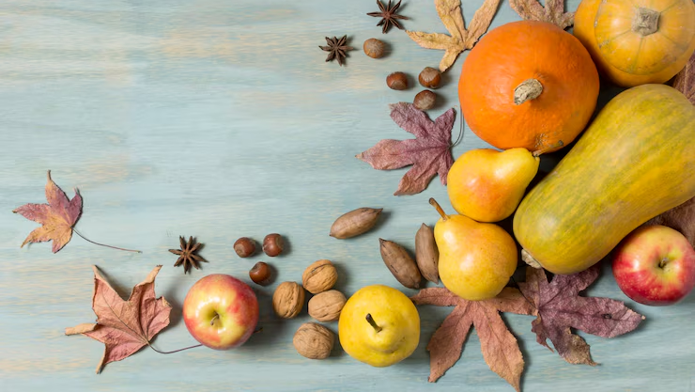
Year 3 — are you ready for the harvest beat?
Everyone: Yeah!
Let’s plant it, grow it, pick it, EAT!
Everyone: Yeah!

Slide 3
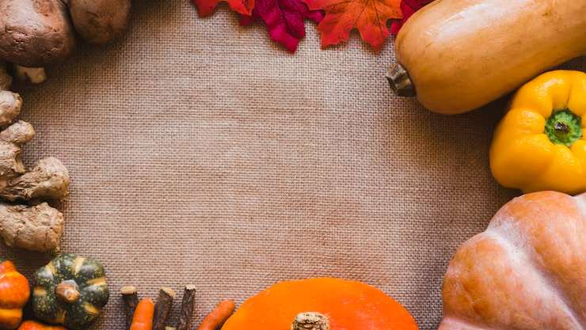
Planting
Plant the seeds, watch them grow,
(stomp, stomp-clap x2)
Sun and rain will help, you know!
(stomp, stomp-clap x2)
Push through the soil, reach for the sky,
(stomp, stomp-clap x2)
Green shoots waving, growing high!
(stomp, stomp-clap x2)

Slide 4
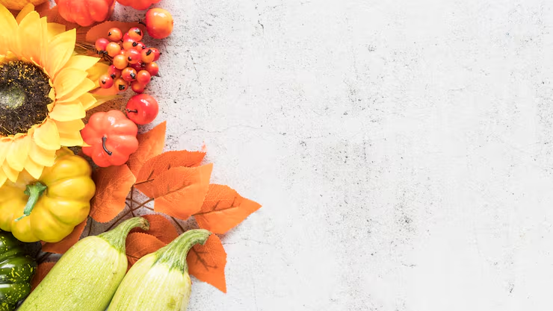
Harvest time (clap-clap) hooray!
Thanks for the food we eat each day!
We thank our God for gifts so good,
He gives us all our daily food!
Stomp your feet, now spin around,
Harvest joy is all around!

Slide 5
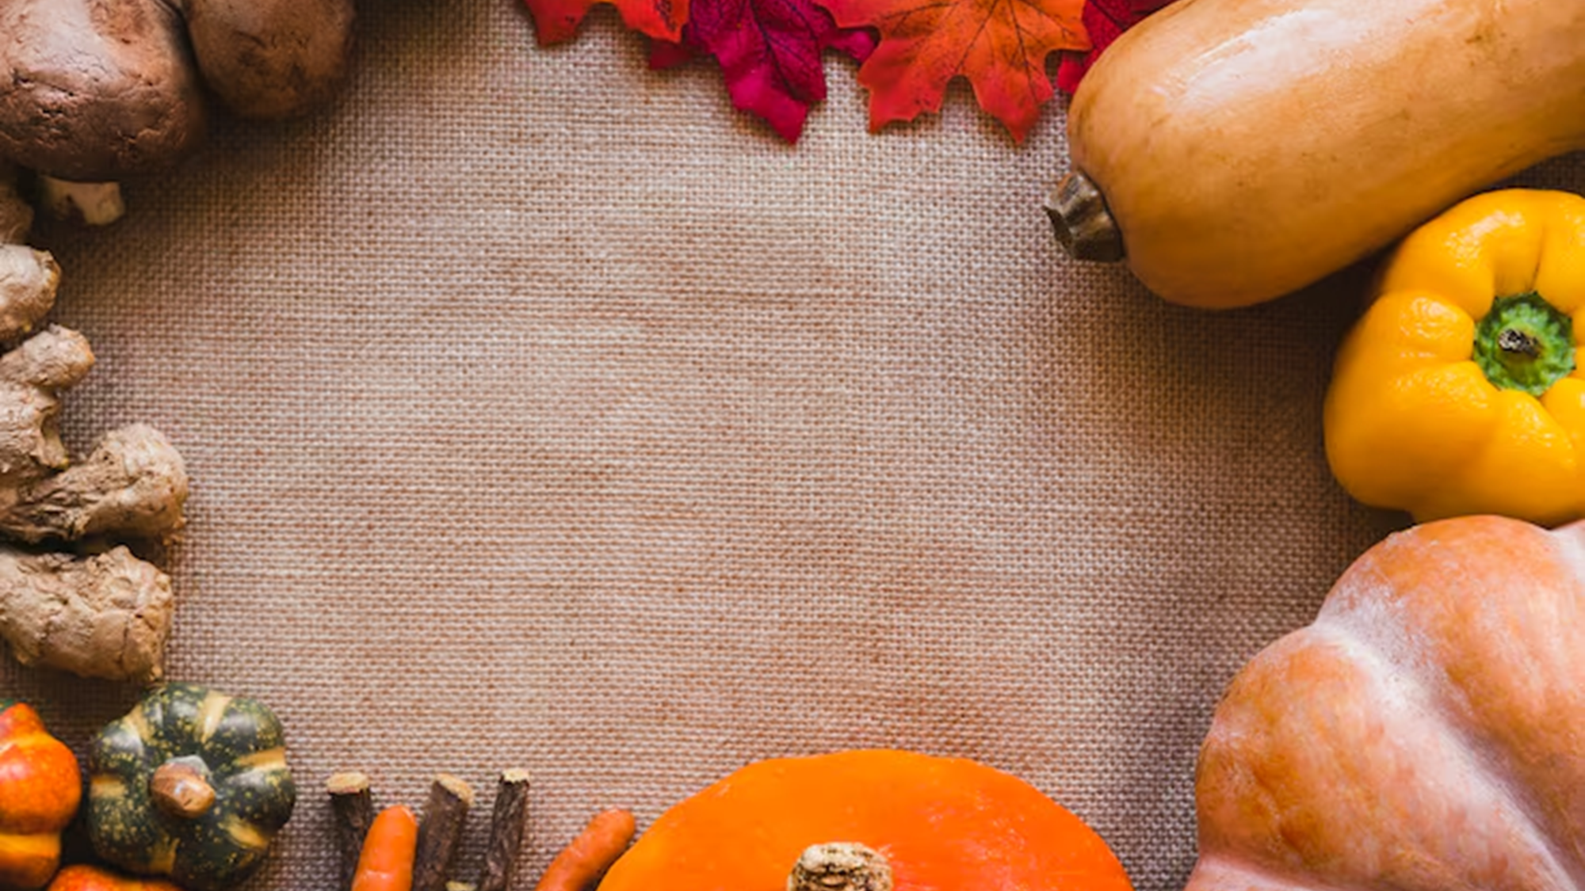
Growing
Wheat in the fields, apples on the tree,
(stomp, stomp-clap x2)
Pumpkins as round as they can be.
(stomp, stomp-clap x2)
Carrots and cabbages, yummy to munch,
(stomp, stomp-clap x2)
Plenty of food for a harvest lunch!
(stomp, stomp-clap x2)

Slide 6

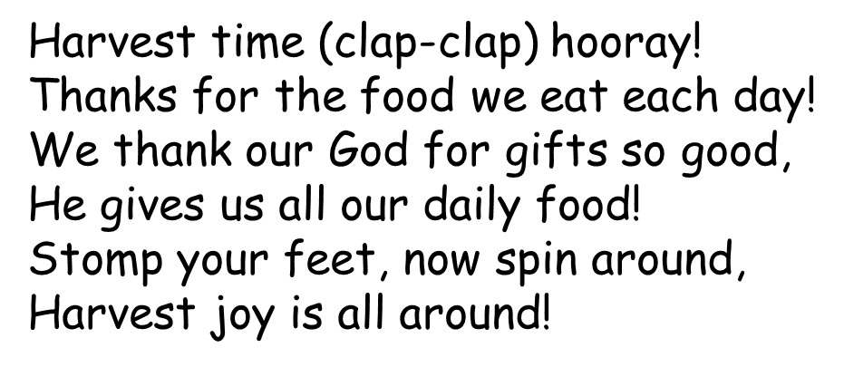

Slide 7
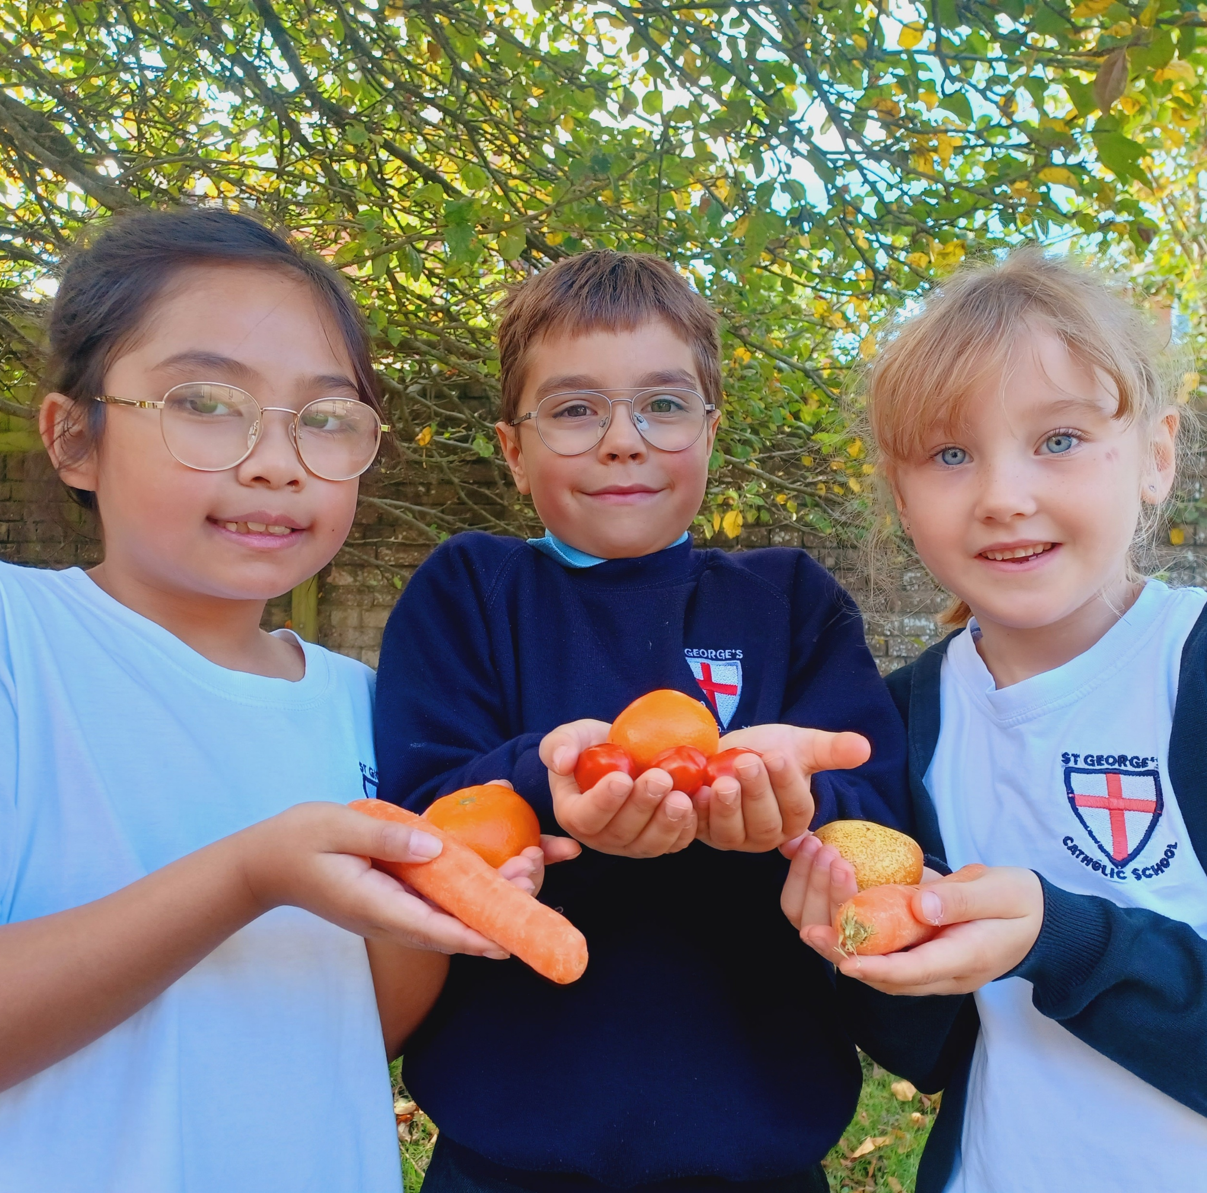
Thank you for listening to our Harvest Rap!

