Slide 2
What is the Jubilee ?

Slide 4
A reading from The Gospel of Luke
Jesus went back to Nazareth, where he had been brought up, and as usual he went to the synagogue on the Sabbath. When he stood up to read from the Scriptures, he was given the book of Isaiah the prophet. He opened it and read,

Slide 5
“The Lord's Spirit has come to me, because he has chosen me to tell the good news to the poor. The Lord has sent me to announce freedom for prisoners, to give sight to the blind, to free everyone who suffers, and to say, ‘This is the year the Lord has chosen.’ ”

Slide 6
Jesus closed the book, then handed it back to the man in charge and sat down. Everyone in the synagogue looked straight at Jesus.
Then Jesus said to them, “What you have just heard me read has come true today.”

Slide 9
What are your hopes ?

Slide 10
“Everyone knows how to hope”
Pope Francis Spes Non Confundit – Hope does not disappoint

Slide 12
Clean water
Enough food
Safe home
School
Doctor or nurse
Live in peace

Slide 14
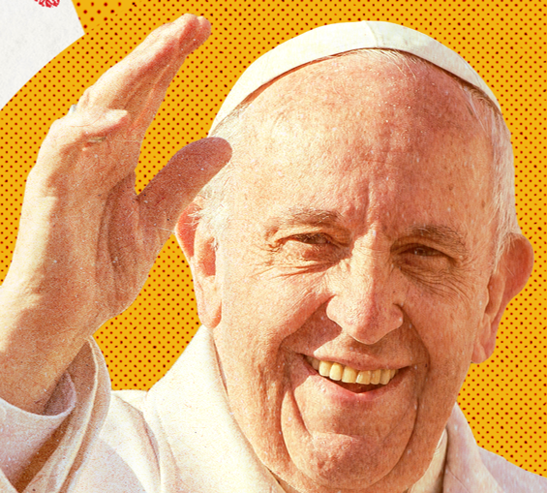
Rome
Pope Francis

Slide 15
Going on a journey

Slide 16
Catholic Social Teaching Link
Everyone is special
(Human Dignity)

Slide 17
Ukraine
Catholic Social Teaching Link
Everyone is Special
(Human Dignity)

Slide 18
Yuliia (7)
Credit: Svitlana Dmytrenko

Slide 19
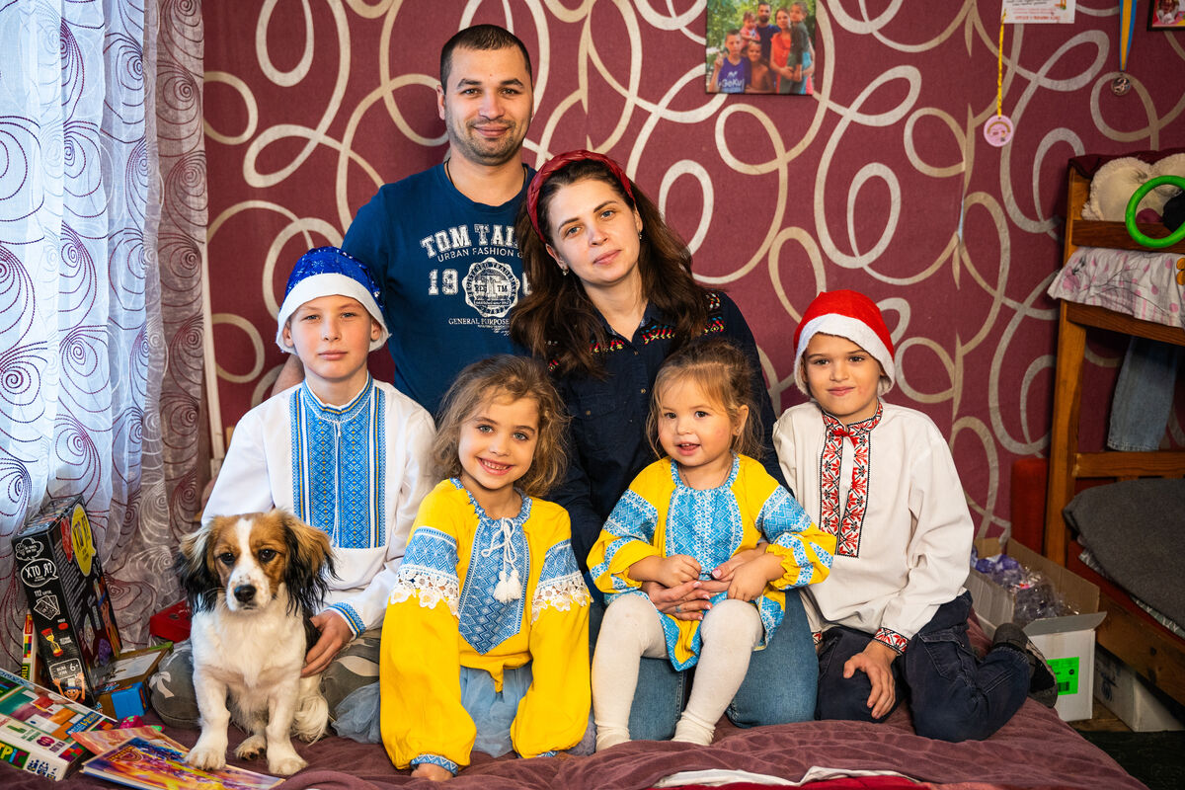
Yuliia with her parents Stephan and Maria,
Her brothers Andrii and Oleh, and her sister Varvara
Credit: Svitlana Dmytrenko

Slide 20
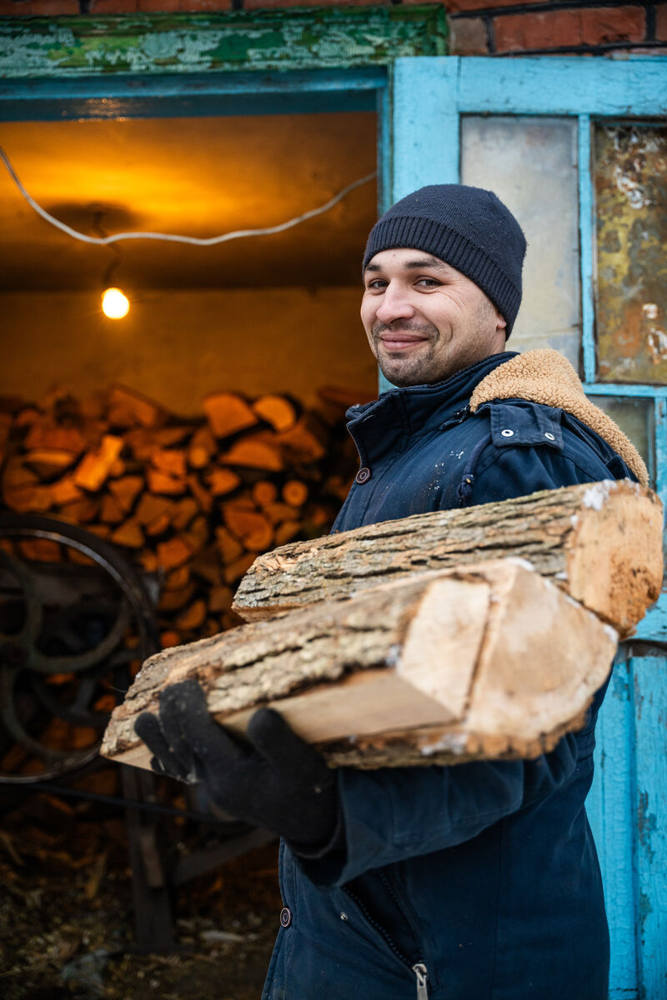
Stephan with the firewood which keeps the family warm in winter

Slide 21
What will you put in your bag?

Slide 22
Clean water
Enough food
Safe home
School
Doctor or nurse
Live in peace

Slide 24
Catholic Social Teaching Link
Everyone should have a say
(Subsidiarity)

Slide 25
Cancel debt, choose HOPE

Slide 26
Let us pray

Slide 27
God, our loving Father,
In this Jubilee year,
you remind us of our call to love creation.
Help us to work together
to replant, repair, and renew.
Guide us on our journey as pilgrims of hope.

Slide 28
Jesus, our light,
In this Jubilee year,
you remind us of our call to love our neighbours and to set free those who suffer.
Help us to treat everyone with dignity;
to be fair, forgiving and kind.
Guide us on our journey as pilgrims of hope.

Slide 29
Holy Spirit, our inspiration,
In this Jubilee year, you remind us of our call to grow in faith and love.
Help us to hear you in scripture, to see Jesus in others, and to be united as God’s global family.
Guide us on our journey as pilgrims of hope. Amen

Slide 30
Thank you

