Slide 1
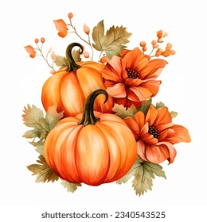
St George’s
Harvest Festival 2025

Slide 2



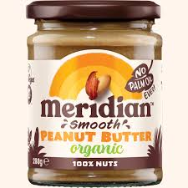

We are moving to a
NUT AWARE SCHOOL status…
NUT AWARE
No school can guarantee being completely nut free, as this creates a false sense of security.
But having children in our school with nut allergies means as a school community, we must aim to be completely NUT FREE to ensure the safety and well-being of these children.
We ask for your help in ensuring ABSOLUTELY NO NUTS and no nut products come to school, in lunch boxes or as class treats.
Thank you for your assistance with this.

Slide 3

Harvest Hymn –
Give Thanks

Slide 4
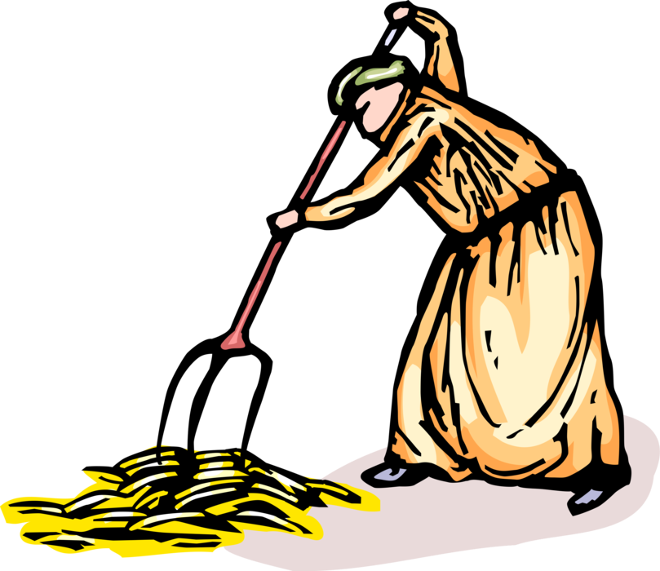
1
Long before the summer started,
Fields were ploughed and sown.
Seeds were scattered, crops were planted, Now they are full grown.
CHORUS
Give thanks for the harvest,
The sun, the seed, the rain.
Give thanks to God the Father,
For harvest time again.

Slide 5

April showers and sunny weather
Fed the earth again.
Warmth and moisture both together,
Helped to grow the grain.
CHORUS
Give thanks for the harvest,
The sun, the seed, the rain.
Give thanks to God the Father,
For harvest time again.
2

Slide 6

Every field of golden yellow,
Standing in the sun,
Tells how God in all His splendour,
Cares for everyone.
CHORUS
Give thanks for the harvest,
The sun, the seed, the rain.
Give thanks to God the Father,
For harvest time again.
3

Slide 7

4
Come with thankful hearts and voices,
Come with joyful song,
For the good food all around us,
Now the work is done.

Slide 8
4
CHORUS
Give thanks for the harvest,
The sun, the seed, the rain.
Give thanks to God the Father,
For harvest time again.
Give thanks for the harvest,
The sun, the seed, the rain.
Give thanks to God the Father,
For harvest time again.

Slide 9

Reception Class
Dingle Dangle Scarecrow.
We thank you God for our crops.

Slide 10

Class 1
A Song - We thank you God for ……….

Slide 11
Choir
Everywhere Around Me

Slide 12
Tell me who made all of creation,
Who designed the wonders of nature?
Whose idea was pattern and colour, Wonderful to see?
CHORUS
Everywhere around me
I can see the hand of God,
The evidence surrounds me,
In the greatness of His world. (Repeat)
1

Slide 13
Tell me who made music and laughter,
Who designed our bodies to start with?
Whose idea was thinking and feeling,
Who gave life to me?
CHORUS
Everywhere around me I can see the hand of God,
The evidence surrounds me
In the greatness of His world. (Repeat)
2

Slide 14
Don’t stop looking, don’t stop believing,
God is to be found when you seek Him.
All creation tells of His glory,
For eternity.
CHORUS
Everywhere around me,
I can see the hand of God,
The evidence surrounds me,
In the greatness of His world. (Repeat)
Everywhere around me!
3

Slide 15
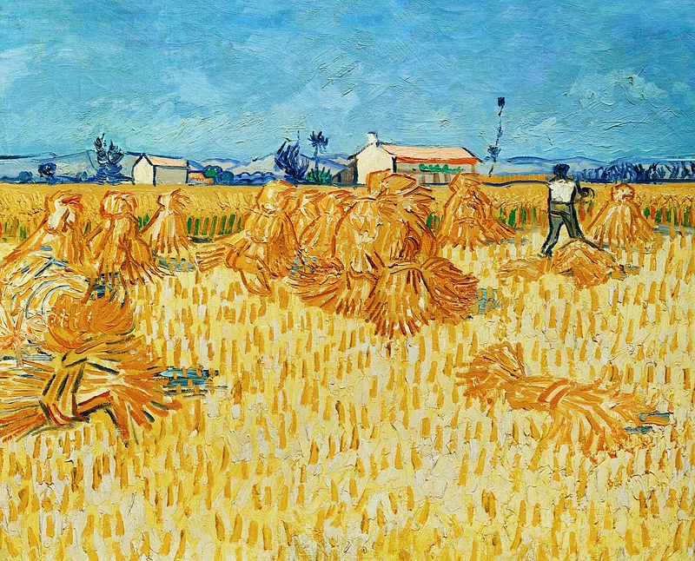
Class 3
Harvest Rap.

Slide 16
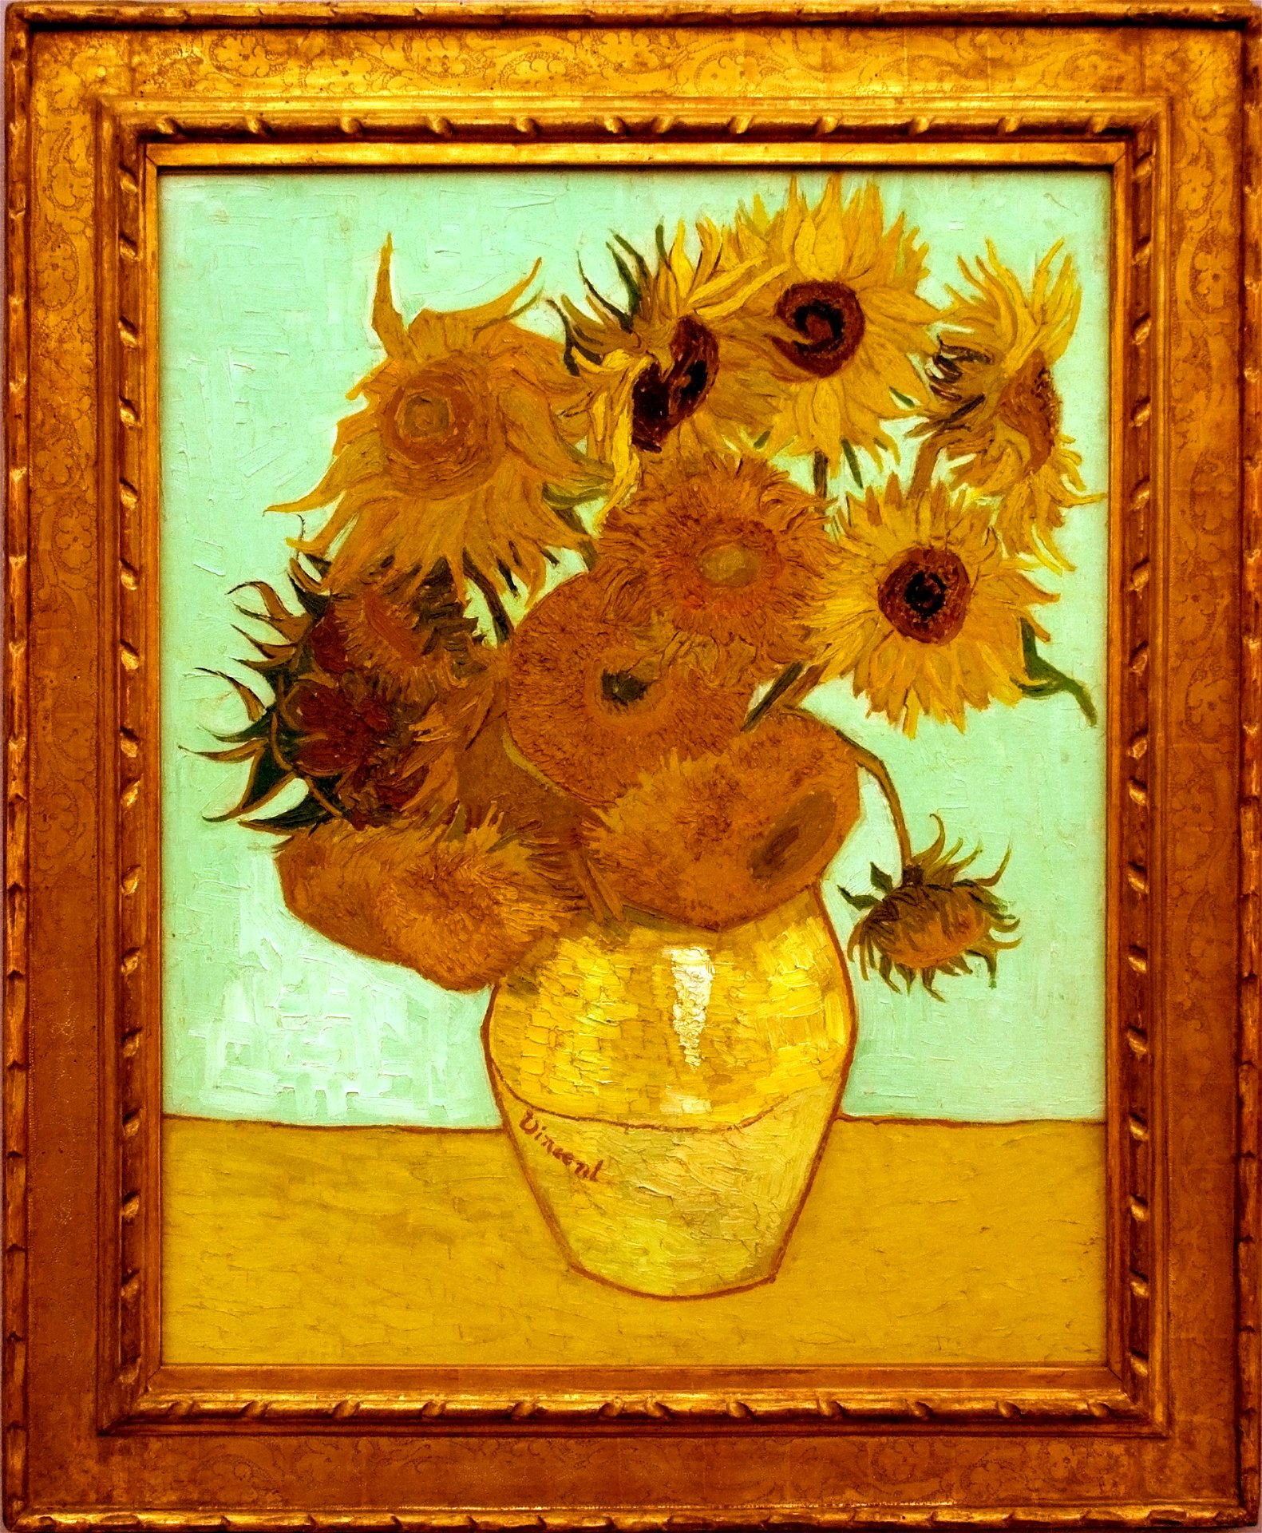
Class 4
Poetry– We thank you God for ……...

Slide 17


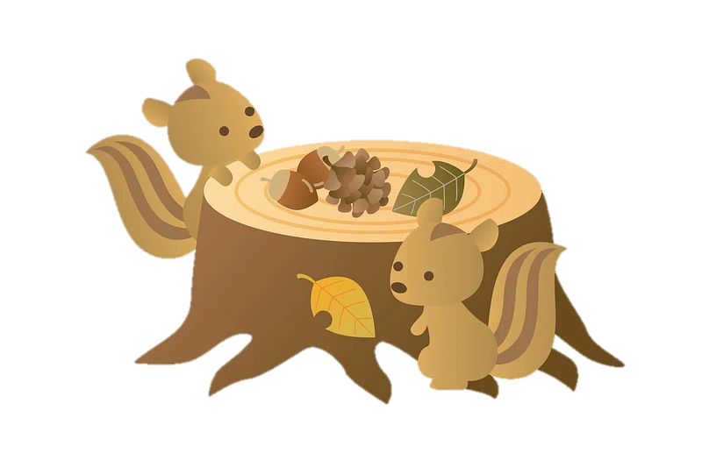
Autumn Days

Slide 18
Autumn days when the grass is jewelled
and the silk inside a chestnut shell,
jet planes meeting in the air to be refuelled,
all these things I love so well.
Refrain:
So I musn’t forget. No I musn’t forget,
to say a great big thank- you, I musn’t forget.
1

Slide 19
Clouds that look like familiar faces,
and a winter’s moon with frosty rings,
smell of bacon as I fasten up my laces
and the song the milkman sings.
Refrain:
So I musn’t forget.
No I musn’t forget,
To say a great big thank- you, I musn’t forget.
2

Slide 20
Whipped up spray that is rainbow-scattered,
and a swallow curving in the sky.
Shoes so comfy, though they’re worn-out
and they’re battered,
and the taste of apple-pie.
Refrain:
So I musn’t forget. No I musn’t forget,
to say a great big thank- you, I musn’t forget.
3

Slide 21
Scent of gardens when the rain’s been falling,
and a minnow darting down a stream,
picked-up engine that’s been stuttering and
stalling, and a win for my home team.
Refrain:
So I musn’t forget.
No I musn’t forget,
To say a great big thank- you, I musn’t forget.
4

Slide 22
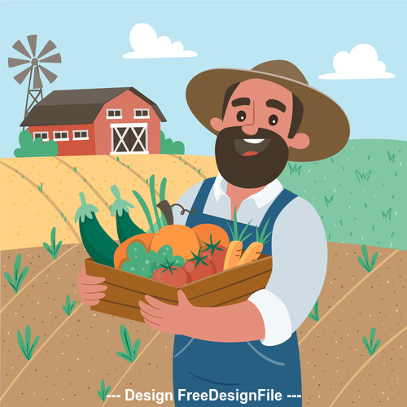
Class 5
Haiku – We thank you God for hardworking hands that unite to gather the Harvest.

Slide 23

Class 2
A collage – We thank you God for …………….

Slide 24

Class 6
A Greek Harvest – We thank you God for the CAFOD whose work enables us to share the Harvest.

Slide 25
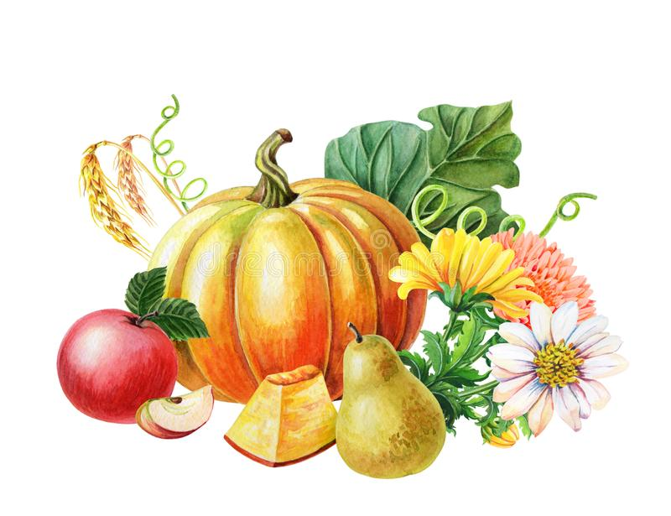
Harvest Prayer
Generous God,
we praise and thank you
for all that you have given us.
Fill our hearts with your love
and move us to be good neighbours
to all our sisters and brothers.
Inspire us all to play our part,
to build a better world
where each and every person
can share in the joy of your gifts.
Amen.
Catherine Gorman/CAFOD

Slide 26

Harvest Message
Matthew 9:37-38
Then he said to his disciples, “The harvest is plentiful but the workers are few. Ask the Lord of the harvest, therefore, to send out workers into his harvest field.”
Let us be workers this harvest time.

Slide 27
THANK YOU FOR ALMOST EVERYTHING!
Thank you for carrots and peas,
Thank you for honey from bees,
Thank you for everything Except for brussel sprouts!

Slide 28
Thank you for curry and rice, Thank you for strawberry ice, Thank you for everything Except for mouldy cheese!

Slide 29
Thank you for raspberry jam, Thank you for bacon and ham, Thank you for everything, Except for pickled eggs!

Slide 30
Thank you for barbeque sauce, Thank you for ketchup of course, Thank you for everything,
Except for garlic snails!

Slide 31
Thank you for chicken to roast, Thank you for baked beans on toast,
Thank you for everything Except for mushy peas!

Slide 32
Thank you for liquorice strings, Thank you for chocolaty things, Thank you for everything Except for sour cream!

Slide 33
Thank you for sausage and chips, Thank you for grapes with no pips, Thank you for everything, (Spoken)
Well, almost everything,
Almost everything!

Slide 34
Thank you
for coming to our
Harvest Festival

