Slide 1
Peace
Welcome to Miss. Roberts’ assembly ☺

Slide 2
Notes:
Moment for reflection – no music. Can the children create a peaceful environment.

Slide 3
Catholic Social Teaching on Peace
What does peace mean?
calm, harmony, love, and kindness.
peace isn’t just the absence of fighting, but it's also about treating others with respect, kindness, and creating a world where everyone can live without fear.
Notes:
Explain that today’s assembly is about one important principle of Catholic Social Teaching: Peace.

Slide 4
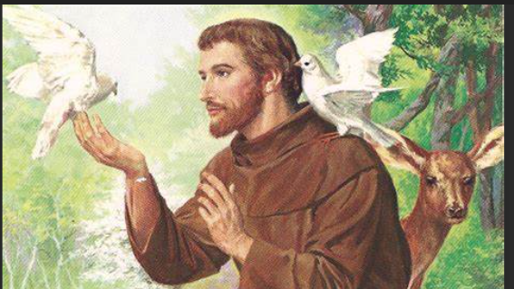
The Story of St. Francis of Assisi
Notes:
Tell the story of St. Francis of Assisi and his role as a peacemaker.

Slide 5
He had love for all people, animals, and nature.
He had a message of peace and reconciliation, including the story of how he tamed a wolf that was terrorizing a village through gentleness rather than violence.
He greeted everyone with “Peace and Goodwill” and worked to build peaceful relationships.

Slide 6
What did St. Francis do to bring peace to the village?
How can we, like St. Francis, be peacemakers in our lives at school or home?

Slide 7
I need a group of children to act out a scenario, showing how they could be peacemakers.
Someone being left out of a group activity.
A disagreement between friends in the playground.
Notes:
Give a group of children a scenario to act out, showing how they could be peacemakers. After each group presents, highlight the peaceful solutions they came up with.

Slide 8
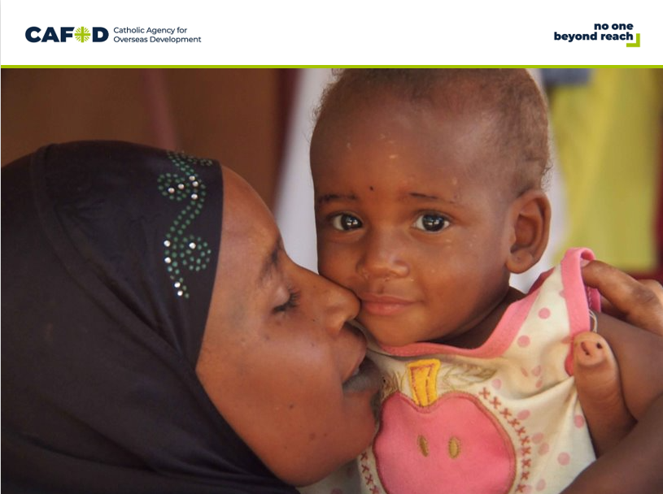
How can we help create peace around the world?

Slide 9
"Peaceful Classroom Pledge"
“I pledge to bring peace wherever I go. I will be kind to others, listen when they speak, and work to solve problems calmly. With God’s help, I will be a peacemaker.”

Slide 10
"Lord, we thank you for your gift of peace. Help us to carry that peace in our hearts every day, to spread it with our actions, and to make our world a better place. Amen."
Notes:
Finish the assembly with a closing prayer, asking God to help everyone live in peace:

