Slide 1
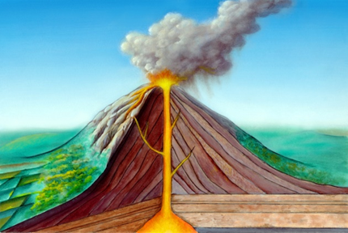
 | Knowledge Organiser Term: Autumn Term Year 5: Geography (Volcanoes, Earthquakes)
Vocabulary
word | definition
crust | The outermost layer of the earth. That’s the layer we walk on.
mantle | Earth’s largest layer of rocks
core | The innermost layer of the Earth with temperature of 5200⁰C.
Tectonic plates | Irregularly shaped slab of solid rock, generally composed of both continental and oceanic lithosphere
magma | Hot liquid inside of a volcano
vent | openings in the Earth's crust from which magma and volcanic gases escape onto the ground
crater | An opening of the volcano
earthquake | Sudden shaking of the ground caused by the movement of tectonic plates
tsunami | A series of waves caused by a large volume of water
volcano | mountain formed by the eruption of molten rock from underground.
seismograph
Key information
The crust, the outer layer of the Earth, is broken into large pieces called plates.
The plates move across the surface of the Earth, along with part of the mantle underneath.
There are seven major tectonic plates that make up 94% of the earth surface.
Most popular volcanoes include Mount Etna, Mount Vesuvius, Mauna Loa, Mount Saint Helens. Mount Fuji and Eyjafjallajökull.
Volcanoes can be active, dormant or extinct.
The Pacific Ring of Fire is a path along the Pacific Ocean characterized by active volcanoes. And earthquakes.
What happens when movement of tectonic plates occurs?
Enquiry Questions: Why do some people choose to live by the volcanoes? Would you choose to live there too?
Land around the volcano is often fertile, leading to bumper harvest.
Heat energy from underground can be used to heat people’s homes or generate electricity.
Volcanoes are tourist attraction so people can make money from visitors to the area.
However:
Gases or clouds of hot ash travelling at high speed can kill people and animals living on or close to the mountain.
Falling ash may cover plants, leaving animals with nothing to eat and destroying crops.
An eruption could lead to local food shortages, or even a famine.
Additional information
Do you know how hot lava is?
Volcanoes can be often kkkkkkkkkkkkkkkkkk found at meeting points of kkkkkkkkkkkkkkkkkk tectonic plates.

