Slide 1
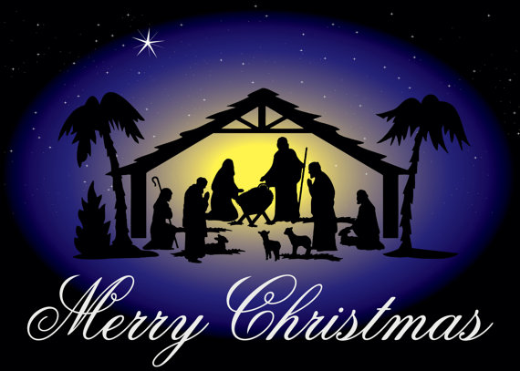
St George’s Catholic School
Christmas Service
Wednesday 18th December 2024
at 2pm

Slide 2

Order of Service
Year 4 – Ukuleles
Welcome – Mrs McDonnell
Year 6 Reader
Instrumental Interlude
Carol – How Far Is It To Bethlehem?
Class 6 – Angels: The Annunciation
Carol - Love Shone Down
Class 3 – Our Saviour is Born – The Birth of Jesus
Carol - Like a Candle Flame
Class 4 – The Shepherds
Carol - There is a Star in the East
Class 5 – Wise Men on Their Camels
Class 5 – Three Gifts For The Baby
School Choir – Away In A Manger
Class 3 – Recorders
Class 6 – French Carol – Le Sommeil de L’enfant Jésus
Carol – Zither Carol
Final Blessing – Father Tom Dubois
KS1 Nativity Song
All – We Wish You A Merry Christmas

Slide 3
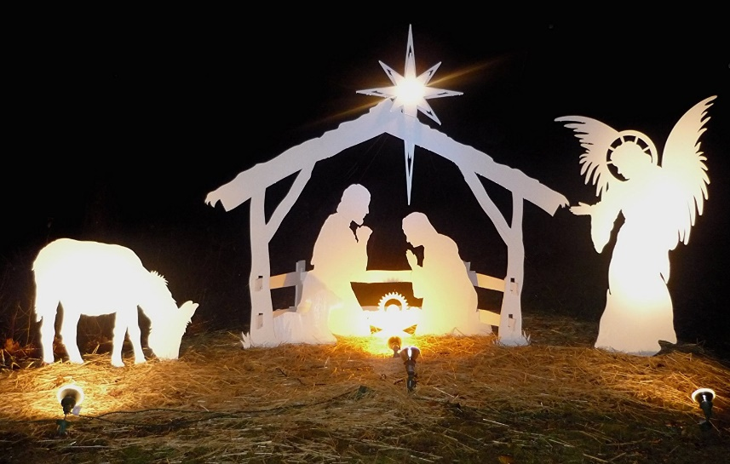
Year 4 – Ukuleles
Music by A Year 6 Pupil
Welcome: Mrs McDonnell
Y6 Reader
Welcome to our Key Stage 2 Carol Service. As we gather together to celebrate the end of another successful term at St. George’s School, we have been busy preparing to celebrate the birth of our Lord and Saviour. During the season of Advent, we encourage you to take time to reflect on the true meaning of Christmas here at our Service this afternoon. We will retell the Christmas story, paying special attention to the different people who had a role to play in heralding or witnessing the coming of Jesus.
But first, please listen to an instrumental piece by one of our school musicians.
Musical interlude

Slide 4
How far is it to Bethlehem ?
How far is it to Bethlehem ?
Not very far.
Shall we find a stable room lit by a star?
Can we see the little child, is he with-in?
If we lift the wooden latch may we go in?
May we stroke the creatures there,
ox, ass or sheep?
May we peep like them
and see Jesus asleep?
If we touch his little hand will he awake?
Will he know we’ve come so far
just for his sake?
Great kings have precious gifts,
and we have naught,
Little smiles and little tears are all we brought.
For all weary children Mary must weep.
Here on his bed of straw sleep,
children, sleep.
God in his mother’s arms,
babes in the byre,
Sleep, as they sleep
who find their heart’s desire.

Slide 5
Class 6: Angels: The Annunciation
The Angel Gabriel was a messenger from God who heralded the coming of the baby Jesus. We take our account from the gospel of Luke.
The Angel Gabriel appeared to Zechariah with the good news that his wife Elizabeth would have a son named John, who would grow up to be a great prophet and prepare the way for the coming of the Messiah.
After this, he had another message from God to deliver. Gabriel appeared again, this time to a girl called Mary who was a cousin of Elizabeth.
While Mary was sitting alone one day, she was suddenly aware of someone standing before her: it was the Angel Gabriel.
“I bring you greetings, Mary!” he said. “The Lord is with you and he has greatly blessed you.”
Mary was amazed. She could not think what he could mean. “Do not be afraid, Mary,” the angel said. “God has chosen you to be the mother of his son. You will call him Jesus. He will be a king, just as his ancestor David was, and his reign will never end.”
“But I am not married yet,” replied Mary, who was engaged to be married to a carpenter called Joseph.
“God’s Holy Spirit will come upon you, and the power of the Most High will overshadow you; for that reason, the holy child will be called the Son of God.”
Mary gazed at God’s messenger. She did not really understand what he was saying, but she knew he had been sent by the Lord.
“I know I belong to God,” Mary answered. “I am ready to do what he wants.”
When Mary was alone again, she thought about what Gabriel had told her.
God was going to send the Saviour they had been waiting for. And he had chosen her to be his mother.
Luke 1: 26-38

Slide 6
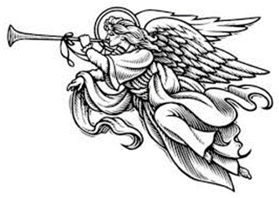
Love Shone Down
I had a dream that I was standing on a hillside, And all the lights of town were shining far below, When up in the air beautiful voices Sing a new song, let everyone know.
Oh and Love shone down Over the hills and over the valleys, Oh and Love shone down Over the world.
Somebody spoke to me, I knew it was an angel. He said: ‘There’s something that I think you ought to know.’ Then he just smiled, said: ‘Don’t be afraid now, Sing a new song, let everyone know.’ [Chorus]
And then he told me all about the baby Jesus, How to find him, where exactly I should go. Then he was joined by millions of others, Sing a new song, let everyone know. [Chorus]
Well, did I dream or was I really on that hillside, On that Christmas night so very long ago? When he was born, Jesus our Saviour, Sing a new song, let everyone know. [Chorus]

Slide 7
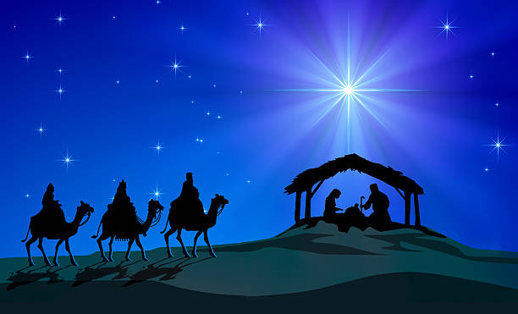
Class 3 Our Saviour is Born: The Birth of Jesus
Mary and Joseph needed to travel to Bethlehem. The Emperor Augustus had called for a register to be taken of all the people in his empire, and everyone had to return to their own hometown to be registered.
The journey could not have come at a worse time, as Mary’s baby was due to be born any day. The journey was long and uncomfortable, and Mary clung to the lurching back of a donkey, mile after tiring mile.
As the town of Bethlehem came into sight, Mary knew the baby was almost here. Joseph knew he just had to find a place for Mary to rest, but the town was full to bursting.
At every inn they visited, Joseph had to shout to be heard.
“A bed? Do you have a bed for my wife?” he pleaded.
“Are you serious? I don’t have as much as a shelf!” replied the inn-keeper.
Joseph began to panic. “But her child! The baby! It’s coming!”
The innkeeper glanced outside at the woman crouched on the ground beside a donkey.
“There’s always the stable, I suppose,” he reflected. “It’s not much, but it’s shelter. May God be with you both, my friend.”
Soon after, the baby boy was born. They swaddled the baby Jesus carefully and laid him in a manger filled with clean straw. Mary and Joseph were overjoyed.
Luke 2: 1-7

Slide 8
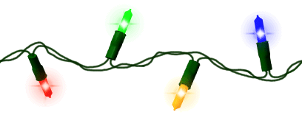
Like A Candle Flame
Like a candle flame,
flickering small in our darkness
uncreated light
shines through infant eyes.
Chorus:
God is with us, alleluia
Come to save us, alleluia
Alleluia!
Stars and angels sing
yet the earth sleeps in shadows;
can this tiny spark
set a world on fire?
Chorus:
God is with us, alleluia
Come to save us, alleluia
Alleluia!
Yet his light shall shine
from our lives, Spirit blazing
as we touch the flame
of his holy fire.
Chorus:
God is with us, alleluia
Come to save us, alleluia
Alleluia!

Slide 9
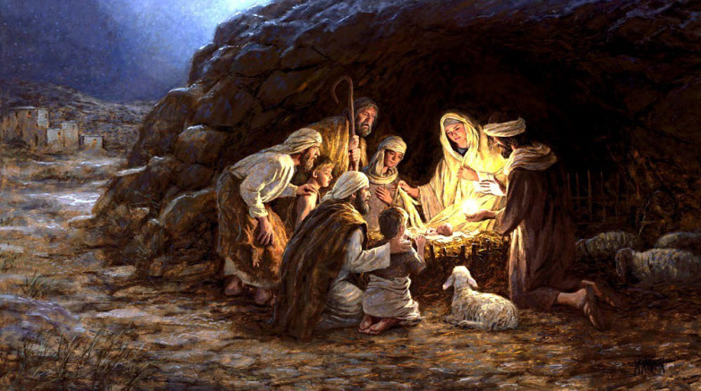
Class 4 The Shepherds
On a hillside in Bethlehem, we, the shepherds, were sitting quietly watching our sheep. Some of us were dozing, and others were keeping a sharp watch out for wolves and rustlers. newborn, the dark sky was ablaze with a blinding light. I jumped up and said, "What's happening?“
"Do not be afraid," the angels replied, "we bring you good news. This very night in Bethlehem your saviour was born, Christ the Lord. You will find the newborn baby wrapped in clothes and lying in a manger in a stable.”
We were confused and a little frightened. We looked up to see a multitude of angels in the sky singing "Glory to God in the highest, peace on Earth and goodwill to all people!" We had never seen or heard anything so beautiful.
When the angels had gone, we went to look for the baby and found him in a stable just as the angels had said, wrapped in swaddling clothes, fast asleep.
I fell to my knees to praise the Saviour in front of me. Everything we had been told was true. Later I told everyone I met about the angel messengers and the newborn king.
Luke 2: 8-20

Slide 10
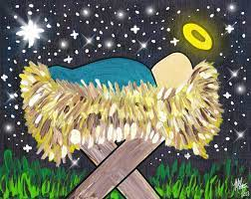
There’s a Star in the East
There’s a star in the east on Christmas morn,
rise up, shepherd, and follow.
It will lead to the place
where the Saviour’s born,
rise up, shepherd, and follow.
Refrain:
Leave your sheep and leave your lambs,
O rise up, shepherd, and follow.
Leave your ewes and leave your rams,
O rise up, shepherd, and follow.
Follow, follow, rise up, shepherd, and follow.
Follow the star of Bethlehem,
rise up, shepherd, and follow.
If you take good heed of the angel’s words,
rise up, shepherd, and follow,
you’ll leave your flocks,
you’ll forget your herds,
rise up, shepherd, and follow.
Refrain:
Leave your sheep and leave your lambs,
O rise up, shepherd, and follow.
Leave your ewes and leave your rams,
O rise up, shepherd, and follow.
Follow, follow, rise up, shepherd, and follow.
Follow the star of Bethlehem,
rise up, shepherd, and follow.

Slide 11
Class 5: The Wise Men
For as long as people have walked on the earth, they have looked up and seen the stars. The stars were there long before the people: same stars, same constellations, same points of light.
But just suppose one night you looked up and saw a new star…
Far away in the East, three astronomers blinked in amazement and stared at one another. ‘A new star? What does it mean?’ said Casper.
‘An omen!’ said Melchior, eyes full of starlight.
‘Saddle the camels!’ said Balthazaar. ‘We must see for ourselves. A child has been born who is going to change the history of the world!’
The three astronomers travelled west, riding on camels and led by the star. They were clutching gifts for the newborn king, for surely the new star signalled the coming of an emperor or a king.
When they reached Jerusalem, they visited the palace of King Herod who was a cruel and jealous ruler.
‘Where is the new king whose birth we have seen written in the stars? We’ve journeyed a long way to pay our respects to him!’ Melchior explained.
Herod felt threatened by the news that the Three Wise Men had come to worship a newborn king. He could barely hide his anger but forced a smile. He encouraged the wise men to return when they had found the baby so he could pay his respects.
After the wise men left, Herod flew into a rage and ordered his soldiers to kill all baby boys in Bethlehem under two years old.
Meanwhile, the wise men continued to follow the star, all the way to Bethlehem. It must have made a strange sight as the three magnificently dressed strangers rode their camels through the dusty, narrow streets.
Imagine their surprise when they arrived at the stable and saw a child wrapped simply in swaddling and laid in a manger, surrounded by animals.
They kneeled as they presented their gifts to the newborn: a bag of gold to represent the birth of a king; a box of frankincense to symbolise his role as a priest who would teach about God; and a jar of myrrh to symbolise his death. Three gifts, one for every part of his life. His birth. His life. His death.
The journey ahead would be dangerous, but cradled in Mary’s arms was the saviour of the world, and she could feel God’s presence with them.

Slide 12
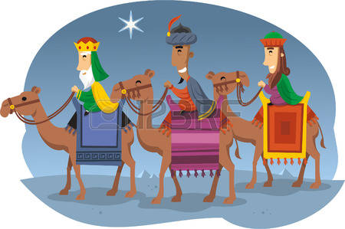
Year 5 – Wise Men on Their Camels

Slide 13
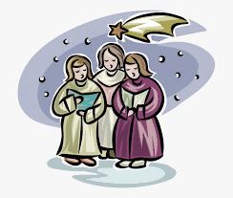
Away in a manger, no crib for a bed, The little Lord Jesus laid down his sweet head. The stars in the bright sky looked down where He lay, The little Lord Jesus asleep on the hay. The cattle are lowing, the baby awakes, But little Lord Jesus, no crying he makes. I love thee, Lord Jesus! Look down from the sky, And stay by my side until morning is nigh. Be near me, Lord Jesus; I ask thee to stay Close by me forever and love me I pray. Bless all the dear children in thy tender care, And take us to heaven to live with thee there.
School Choir: Away in a Manger

Slide 14

Year 3 – Recorders
Jingle Bells
Year 6 French Carol
Le Sommeil de L’enfant Jésus

Slide 15
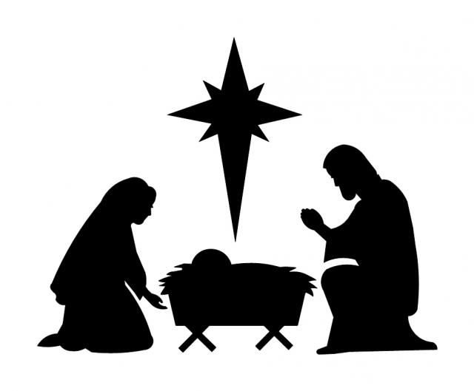
Girls and boys, leave your toys, make no noise,
kneel at his crib and worship him.
For this shrine, Child divine, is the sign
our Saviour’s here.
Alleluia, the church bells ring,
‘Alleluia!’ the angels sing,
alleluia from everything – all must draw near!
On that day, far away, Jesus lay –
Angels were watching round his head
Holy child, mother mild, undefiled,
we sing your praise.
Alleluia, the church bells ring,
‘Alleluia!’ the angels sing,
alleluia from everything – our hearts we raise.
Shepherds came at the fame of your name,
angels their guide to Bethlehem;
in that place, saw your face filled with grace,
stood at your door.
Alleluia, the church bells ring,
‘Alleluia!’ the angels sing,
alleluia from everything – love evermore.
The Zither Carol

Slide 16

Final Blessing
Father Tom
KS1 Carol
Mary’s Lullaby

Slide 17
We Wish You A Merry Christmas
We wish you a Merry Christmas,
We wish you a Merry Christmas,
We wish you a Merry Christmas, and a Happy New Year!
Good tidings we bring to you and your kin,
We wish you a Merry Christmas and a Happy New Year!
So bring us some figgy pudding,
So bring us some figgy pudding,
So bring us some figgy pudding, and a cup of good cheer!
Good tidings we bring to you and your kin,
We wish you a Merry Christmas and a Happy New Year!
We won't go until we've got some,
We won't go until we've got some,
We won't go until we've got some, so bring some out here!
Good tidings we bring to you and your kin,
We wish you a Merry Christmas and a Happy New Year!
We wish you a Merry Christmas and a Happy New Year!

Slide 18


