Slide 1

accommodate
accommodation
We checked in to our holiday accommodation.
Helpful hint:
It had Air Conditioning; good coms(communications); and all mod cons.

Slide 2
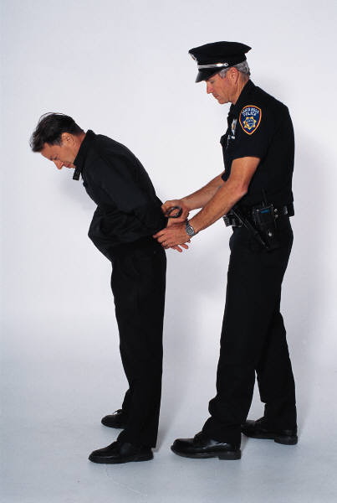
accompany
I’d like you to
accompany me to the
police station.

Slide 3
in accordance with ...
according to ...
according
accordingly
of one’s own accord ...

Slide 4
achieve
Rule: i before e, except after c,
when making an ‘ee’ sound.
achievement
Just add the suffix –ment.
achievable
Drop the e when adding –able.

Slide 5
aggressive
The boxer was very aggressive!

Slide 6
Unusual ending.
French?
amateur
Did you know?
Amateur comes from amator, the Latin word for a lover, because unlike a professional who gets paid, an amateur does something for the love of doing it.

Slide 7
ancient
Ancient
Egypt
Ancient
Greece

Slide 8
apparent
Apparently, ...
It soon became apparent that...

Slide 9

appreciate
appreciate appreciation

Slide 10

attached
attach attached attachment

Slide 11
at one’s disposal
accessible
available
obtainable
availability
antonyms
available - unavailable

Slide 12
average
Mathematically - the mean, median or modal value
The average age of the class is ten years.
Everyday speech - typical; ordinary; run-of-the-mill

Slide 13
awkward

Slide 14
bargain
You gain when you get a bargain.

Slide 15

bruise
Fruit can bruise easily.

Slide 16
category
Which category does each animal belong to?
Big cats
Bears
Categorically speaking will remind you of the unstressed ‘o’ in category.

Slide 17
cemetery

Slide 18
committee
Double ‘m’, double ‘t’, double ‘e’

Slide 19
communicate
communication
communicative
uncommunicative

Slide 20
community
There is unity in the community.

Slide 21
competition
You need to be competitive to compete in a competition.

Slide 22


conscience
con+science

Slide 23
conscious
consciously
consciousness
unconscious

Slide 24
controversy
How do you say the word ‘controversy’?
controversial

Slide 25
convenience
convenient
conveniently

Slide 26
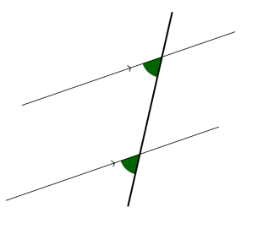
correspond
correspondence
(communication by letter)
correspondent
(a distant reporter)
corresponding
(matching)
correspond

Slide 27

criticise
Remember: A critic can be very critical.

Slide 28

?
curiosity
Curiosity killed the cat.
Notice the spelling change – curious but curiosity.

Slide 29
definite
Definite comes from the same root as finite and finish.
definitely definition

Slide 30
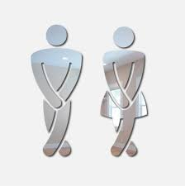
desperate
The word desperation will help you remember the unstressed vowels.

Slide 31
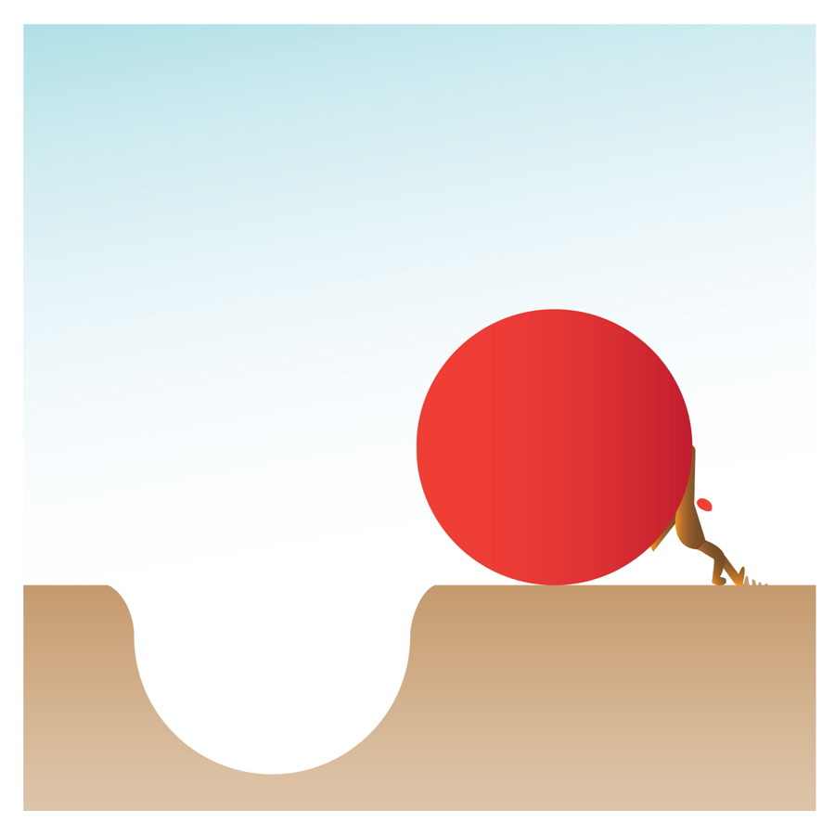
determined
determination

Slide 32
development
develop
developing
developed
de - vel - op

Slide 33

dictionary

Slide 34

disastrous
disaster

Slide 35
embarrass
embarrassed........embarrassment
Notice the double ‘r’ and the double ‘s’.

Slide 36
environment

Slide 37
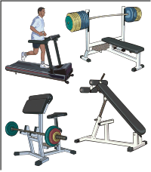
equipment
equip
equipped

Slide 38
especially
Especially for you,
as you’re so
special.

Slide 39
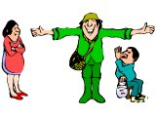
exaggerate
exaggeration

Slide 40
excellent
It’s excellent if you excel and achieve excellence.

Slide 41
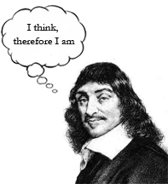
existence
existence
exist existing
Can you devise a way of remembering that it’s
–ence, not –ance??

Slide 42
explanation
Change of spelling: explain becomes explanation.

Slide 43
familiar
The word ‘familiarity’ will help to remind you that the unstressed vowel is an ‘a’.
Did you know that familiar comes from familia, the Latin word for family?
Did you know that familiar comes from familia, the Latin word for family?

Slide 44
foreign
A monarch might reign over foreign lands.

Slide 45
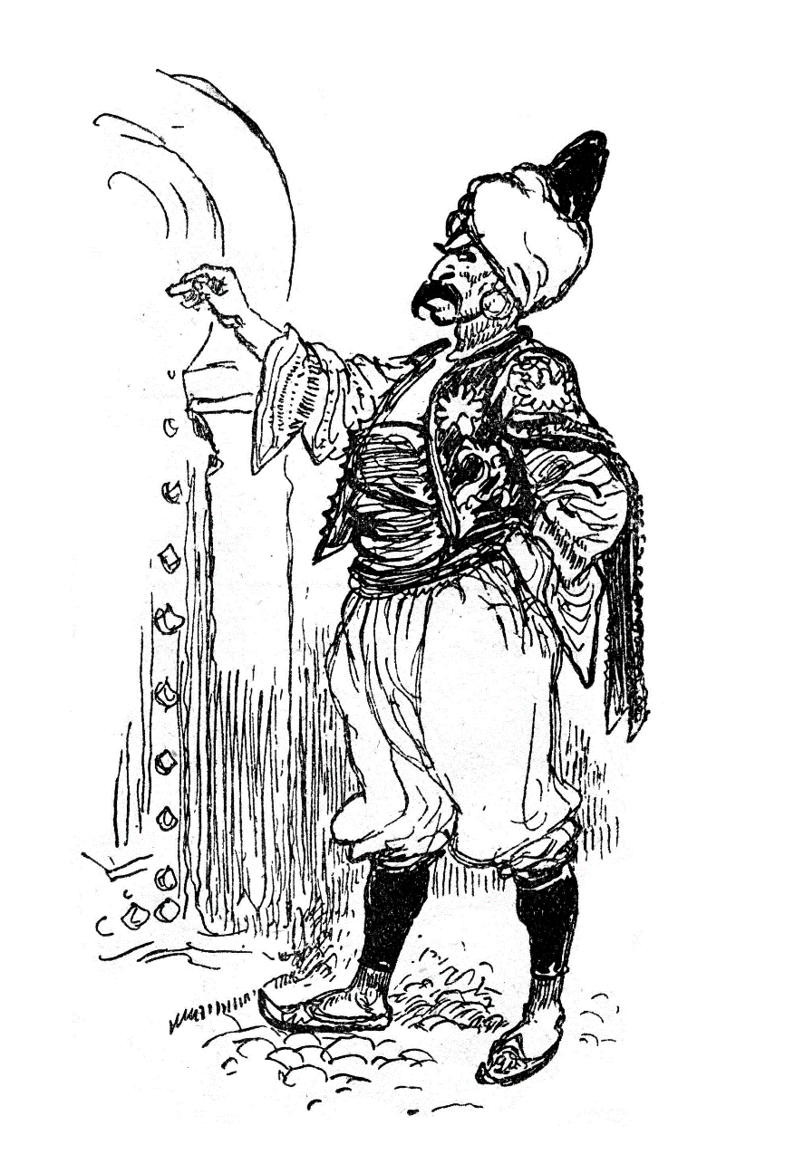
forty
Ali Baba invited
his forty thieves
for tea.
Change of spelling: four – fourteen - forty

Slide 46

frequently
Not to be confused with frequency.
Be aware – frequent can be used as
an adjective or a verb.
frequent (adjective): occurring often
frequent (verb): to visit often

Slide 47
government
Remember: It is the government who govern.

Slide 48
guarantee
Unusual ending – do you know any other words that end like this?
What other words do you know that start like this?

Slide 49
annoy
pester
harass
bother
hassle
hound
harassed – harassing - harassment

Slide 50
hindrance
hinder – hindered – hindering - hindrance

Slide 51
identity
identify - identical

Slide 52
immediate
How do you split immediate up to help you remember the spelling?
Here’s one way: im/me/di/ate
immediately

Slide 53






individual
individually
individuality
Helpful hints
The word individual comes from the Latin word meaning ‘cannot be divided’.
Saying the word individuality will help you identify the unstressed vowels in individual.

Slide 54
interfere
interference
interfering

Slide 55
interrupt
The word interrupt means ‘to break in between’.
It comes from the Latin words ‘inter’ which means ‘between’, and ‘ruptum’ – which means ‘break’. [Think about the word ‘rupture’.]
So if you think of these two parts – inter+rupt – you will always remember the double ‘r’.
inter/rupt

Slide 56

language

Slide 57
leisure

Slide 58
lightning
Don’t confuse with lightening – making something lighter!

Slide 59
marvellous
awesome
superb
astonishing
wonderful
fantastic
Don’t forget to double the ‘l’ when adding the –ous suffix
to ‘marvel’.

Slide 60
mischievous
mischief

Slide 61
muscle
Family words often sound out silent letters ...
muscle ---- muscular
Homophones: muscle - mussel

Slide 62
necessary
It is necessary for a coat to have a collar and 2 sleeves.
necessarily

Slide 63
neighbour
My neighbour lives at number eight.

Slide 64
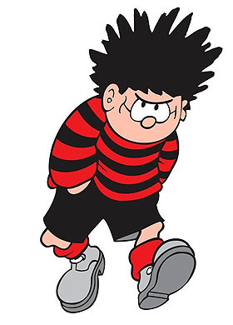
nuisance

Slide 65
occupy
occupy
related words
occupied – occupier - occupation - occupant
antonyms
occupied – unoccupied

Slide 66
occur
Note the double ‘c’ but a single ‘r’.
But the ‘r’ is doubled when adding a suffix…
occurred occurring occurrence
_

Slide 67

opportunity
“a golden opportunity”

Slide 68
parliament
I am in parliament.

Slide 69
persuade
persuasion

Slide 70
physical
The word ‘physical’ comes from the Greek word ‘physikos’, which means ‘natural’.
What other words do you know that start physi-?
Did you know that P.E. stands for Physical Education?

Slide 71
prejudice
If you show prejudice you are literally pre-judging someone or something without all the facts.
[Latin: pre – before judicium – judgement ]

Slide 72
privilege
The teachers at this school all believe it is a privilege to teach such wonderful children.

Slide 73
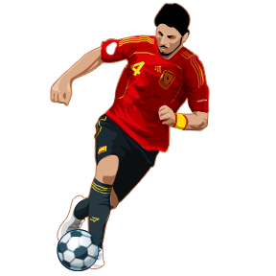
Lots of words end in –ession.
How many can you think of?
Only one ‘f ’
profession
the teaching profession
professional footballer

Slide 74
programme
TV programme
programme of events
theatre programme
programme of study
We use the American spelling when we refer to a computer program.

Slide 75
pronunciation
Notice the change of spelling:
pronounce but… pronunciation

Slide 76

queue
Not to be confused with ‘cue’.

Slide 77
recognise
recognition
recognisable unrecognisable

Slide 78
only one ‘c’
double ‘m’
recommend
recommendation

Slide 79
relevant
A relevant ant

Slide 80

restaurant
aur
rest
ant
The word ‘restaurant’ is French, so the ‘ant’ sounds like ‘ont’.

Slide 81
rhyme

Slide 82
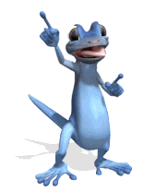
rhythm
rhythm has your two hips moving

Slide 83
sacrifice
Originally, sacrifice was to do with religion. Nowadays, it’s giving up something for the sake of something or someone else.

Slide 84
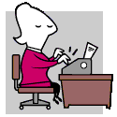
secretary
A good secretary can keep a secret.

Slide 85
shoulder
Can you use shoulder as
a noun? A verb?
An adjective?

Slide 86

signature
The words sign and signature come from the same root.
Family words often sound out silent letters.

Slide 87
sincere
Yours sincerely
Antonyms
sincere - insincere
sincerity

Slide 88

soldier

Slide 89
stomach
Take care: There is only one ‘e’ in stomach ache.
Don’t be tempted to add one to stomach!

Slide 90
sufficient
Antonyms
sufficient - insufficient
Related words
sufficiently - sufficiency

Slide 91
suggest
suggestion

Slide 92
symbol
Homophones
symbol - cymbal

Slide 93
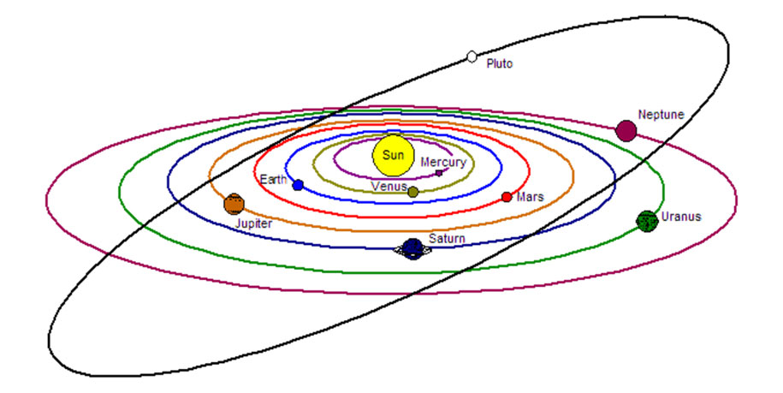
Solar system
system
Related words: systematic - systematically

Slide 94
temperature
How will you remember to spell temp/er/a/ture ?

Slide 95
thorough
thoroughly
The ‘ough’ string appears in lots of words, often making different sounds.
Which words can you think of with ‘ough’ in?
What sound is made by the ‘ough’ string each time?

Slide 96

twelfth
Spelling change: Be aware of twelve but twelfth!

Slide 97

variety
The word variety comes from the Latin word varietas, which means various.

Slide 98
vegetable
Are you able to get the vegetables and put them on the table?

Slide 99

vehicle
Saying the word vehicular may help you remember how to spell vehicle.

Slide 100
yacht
Did you know that yacht comes from an old Dutch word?
This is often misspelt as ‘yatch’ because ‘tch’ is a common letter string. Just remember that it ends in a /t/ sound, and is an unusual word, so it’s ‘cht’.

