Slide 1
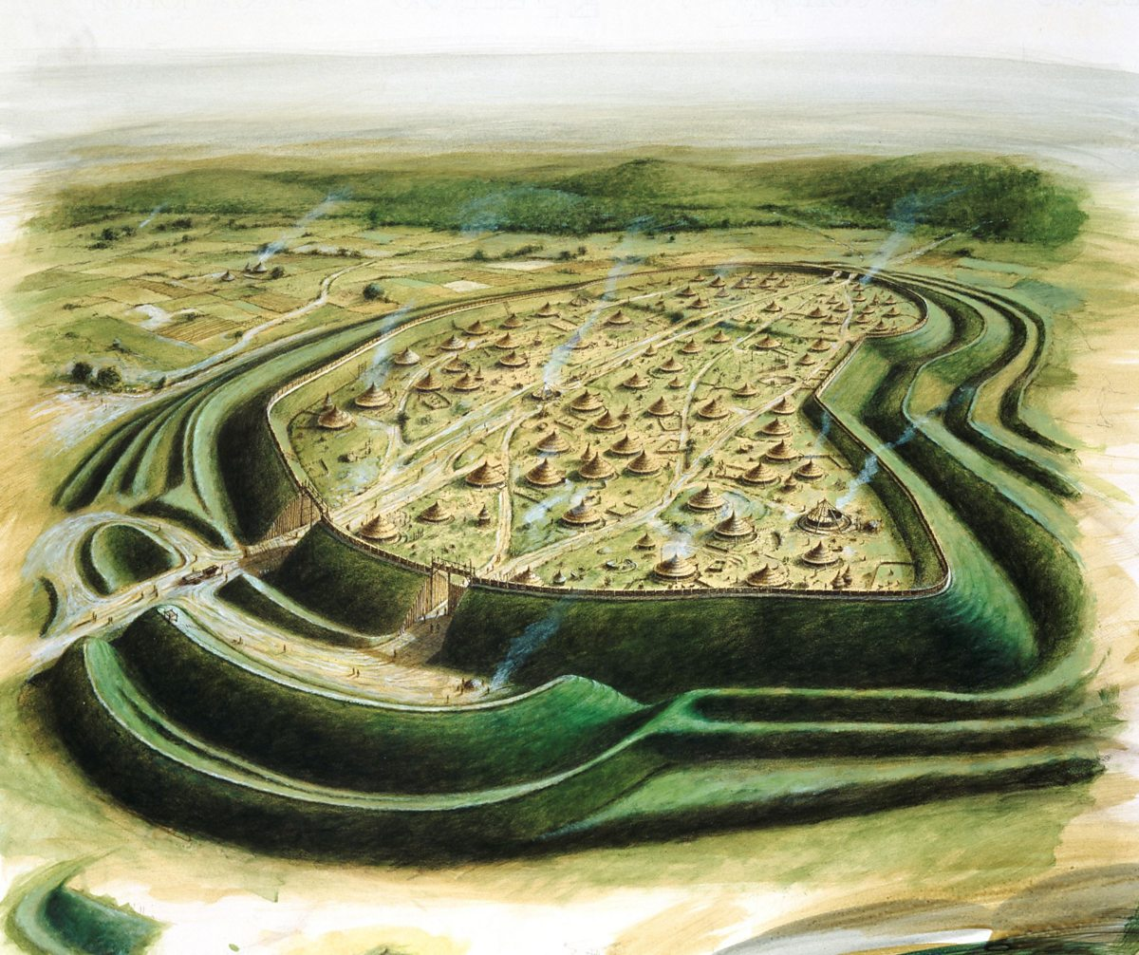
 | Knowledge Organiser Term: Autumn Term Year 5: History
Vocabulary
word | definition
Palaeolithic | a first stage of Stone Age. Early human lived in caves and simple huts
Mesolithic | Period between Palaeolithic and Mesolithic Age.
Neolithic | Final stage of Stone Age. It signified beginning of agriculture.
Cheddar | Location in Somerset where first human remains were discovered in Britain.
Skara Brae | A stone built Neolithic Village, located on the largest island in the Orkney.
flint | Primary material used for making arrows or spear heads.
Hunter- gatherer | Human living in Stone age who survived on wild food
tribe | Social group made up of many families.
cave | Natural opening in the earth, a place where first humans lived.
forge
Key information
Palaeolithic existed between 2.5 million year ago to 10,000 BC
Mesolithic existed between 9000-4300 years ago
Neolithic existed between 4300 BC- 2000 BC
The Cheddar Man-the oldest complete skeleton found in Britain. He had blue eyes and dark skin and he was 166cm tall.
Stone Age people were moving a lot to hunt for food. They were not settling for long. First settlements took place later in Neolithic Period.
Bronze Age settlements were
Iron Age settlements were
Skara Brae – It is a first evidence that society changed from hunter gatherer to settlements.
Beliefs were
Enquiry Question: Would you rather live in the Stone Age, Iron Age or Bronze Age?
The Stone Age is the name given to the earliest period of human culture when stone tools were first used. In Britain, the Stone Age was around 12,000 years ago.
Palaeolithic and Mesolithic people were nomadic hunter gatherers. They moved frequently following the animals that they hunted and gathering fruits and berries when they could.
The dog was the first animal to be domesticated. This happened during the Mesolithic period. Dogs could help with the hunt, warn of danger and provide warmth and comfort.
The Palaeolithic period lasted for such a long time that it accounts for 99% of all human history.
People moved around from place to place so that they could get the food and shelter they needed.
Additional information
Henges were used for:
Hillfort was a defended s settlement to protect enemieshhhhh from enemies.

