Slide 1

Celebration of the word
for primary schools
Jubilee
Pledge

Slide 2
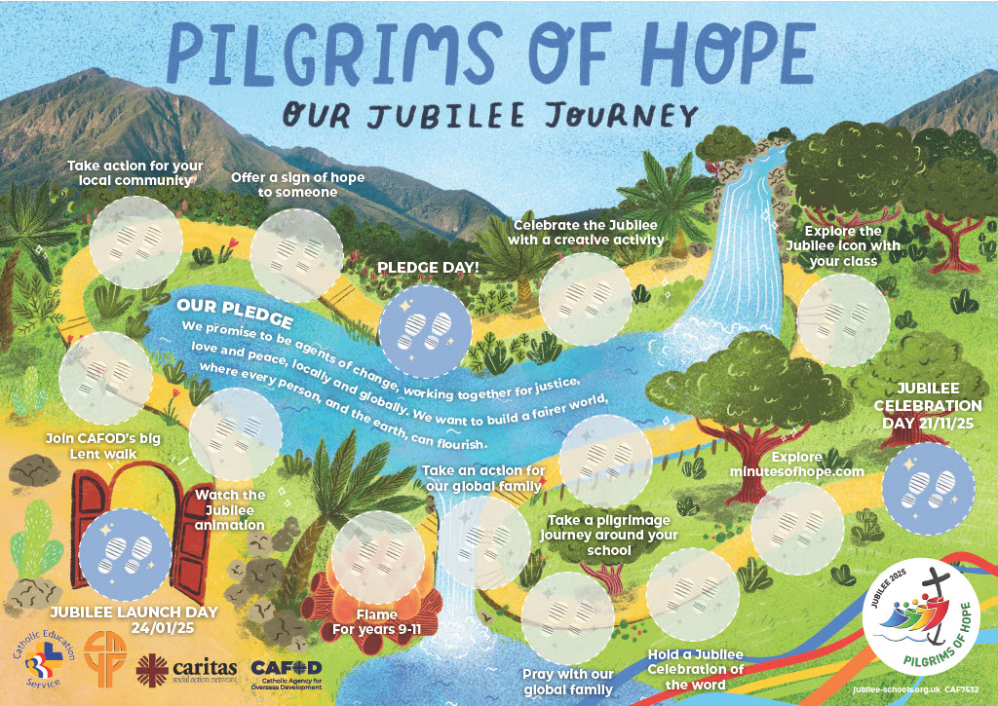



Slide 3



Slide 4
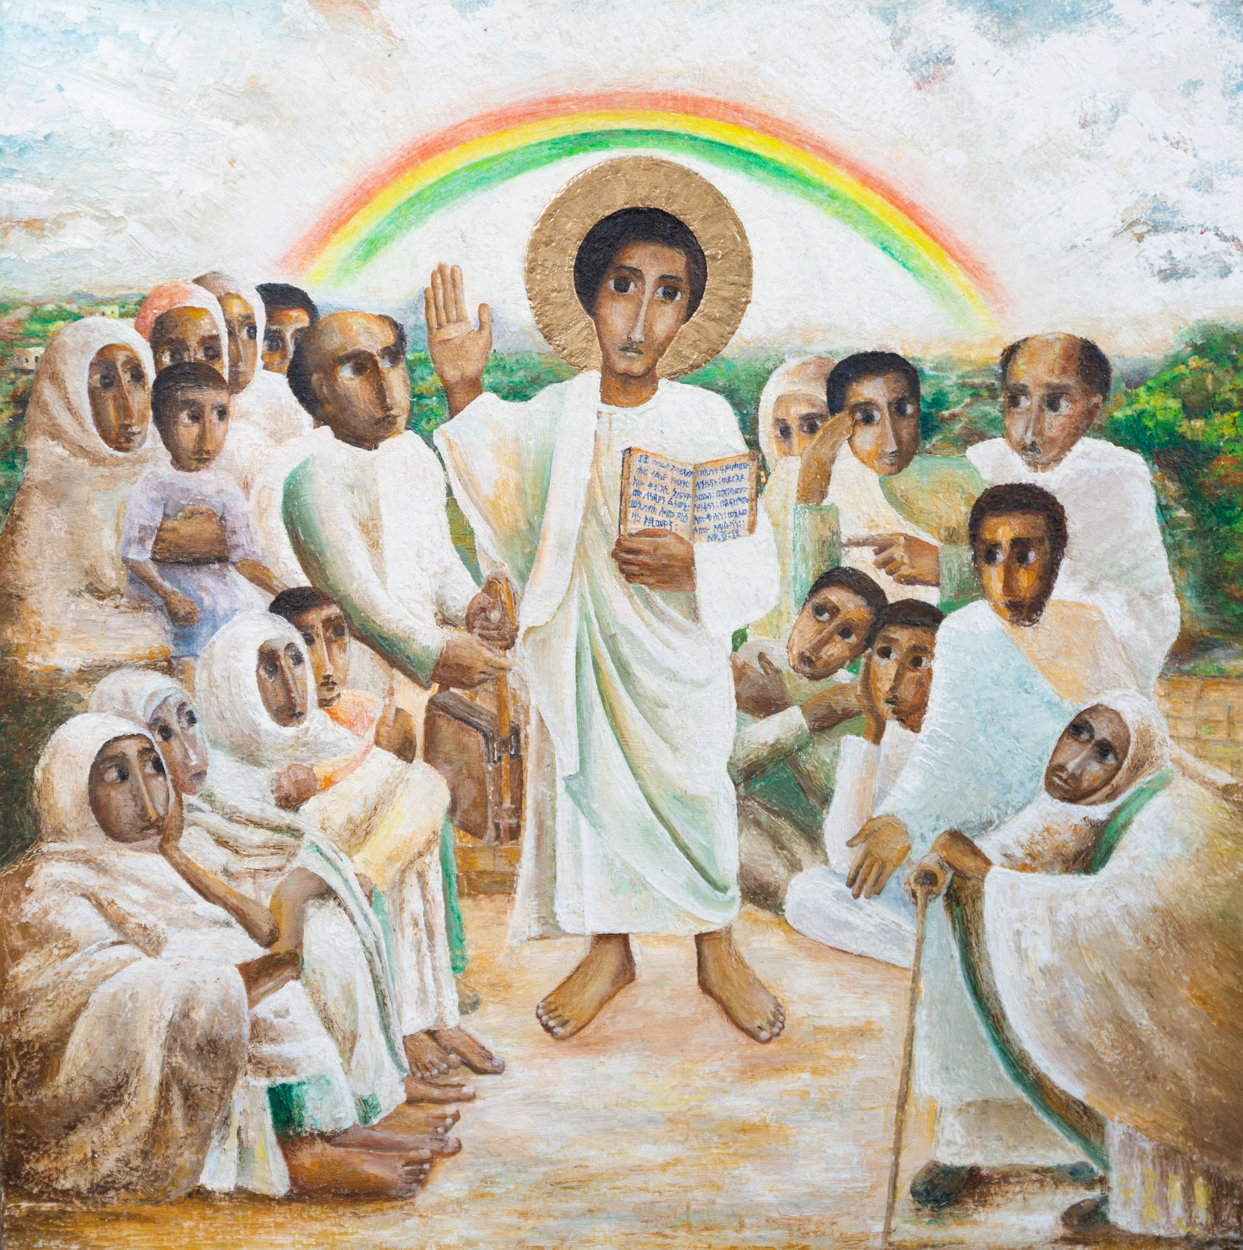



“The Spirit of the Lord is upon me, because he has chosen me to bring good news to the poor. He has sent me to proclaim liberty to the captives and recovery of sight to the blind, to set free the oppressed and announce that the time has come when the Lord will save his people.”
Word

Slide 5

“The Spirit of the Lord is upon me, because he has chosen me to bring good news to the poor. He has sent me to proclaim liberty to the captives and recovery of sight to the blind, to set free the oppressed and announce that the time has come when the Lord will save his people.”
Respond

Slide 6

WHO is in the picture?

Slide 7

WHO is in the picture?

Slide 8



The Jubilee Pledge
We are pilgrims of hope.
We walk in solidarity with our sisters and brothers worldwide, sharing challenges and celebrating joys.
We promise to be agents of change, working together for
justice, love and peace, locally and globally.
We want to build a fairer world, where every person, and the earth, can flourish.
WHO is in the picture?
Everyone should have what they need to live life to the full!

Slide 9
Catholic Social Teaching – the pledge in action!
We recognise the dignity of every person, loved and created by God.
We follow the example of Jesus’ love and his mission to bring good news ‘to the poor’. (Luke 4)
We work for the common good of all, understanding that our actions impact our local and global family because we are all interconnected.
We are good stewards of the earth, knowing that the earth’s gifts are for everyone, not just for a privileged few.
We prepare a path to peace in our world, challenging the root causes of poverty and injustice.
We speak out for debt relief, to set free those who are burdened by unjust debt.
We work together with CAFOD and our local Caritas to be
practical signs of hope and put love into action.
WHO is in the picture?

Slide 10

WHO is in the picture?

Slide 11

A prayer of hope
God, our loving Father,
In this Jubilee year,
you remind us of our call to love creation.
Help us to work together
to replant, repair and renew.
All: Guide us on our journey as pilgrims of hope.
Send

Slide 12
Jesus, our light,
In this Jubilee year,
you remind us of our call to love our neighbours
and to set free those who suffer.
Help us to treat everyone with dignity; to be fair, forgiving and kind.
All: Guide us on our journey as pilgrims of hope.
Send

Slide 13
Holy Spirit, our inspiration,
In this Jubilee year, you remind us of our call to grow in faith and love. Help us to hear you in scripture, to see Jesus in others,
and to be united as God’s global family.
All: Guide us on our journey as pilgrims of hope.
Send

Slide 14

Send

