Slide 1







Jubilee Celebration Day
Celebration of the word
for primary schools

Slide 2



Gather

Slide 3


Slide 4

Notes:
Film: 4.09 mins
We are Pilgrims of Hope – Primary Schools | CAFOD

Slide 5

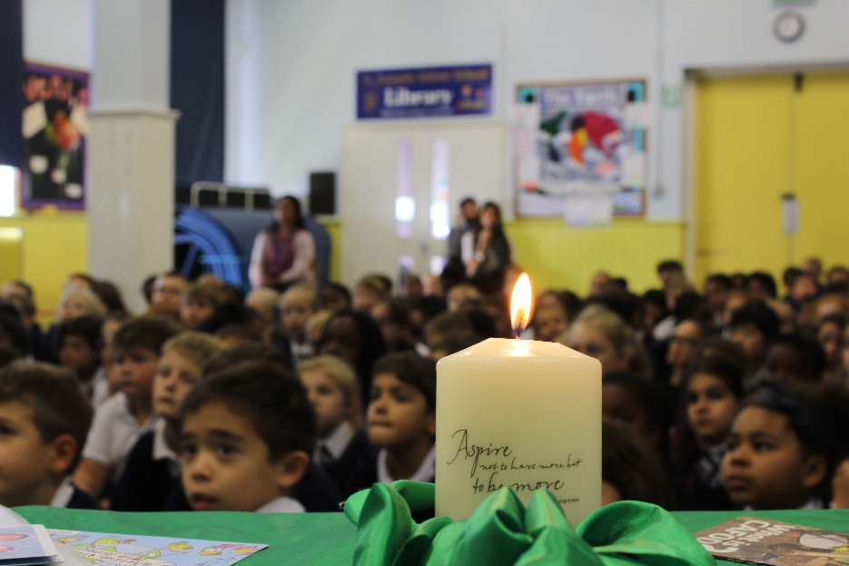
Word
A reading from the Gospel of Luke

Slide 6
“The Spirit of the Lord is upon me,
because he has chosen me to bring
good news to the poor.
He has sent me to proclaim
liberty to the captives
and recovery of sight to the blind,
to set free the oppressed
and announce that the time has come
when the Lord will save his people.”

Slide 7

Respond
SACRED SILENCE…
Think about your Jubilee journey.
How have you been a sign of hope this year?

Slide 8
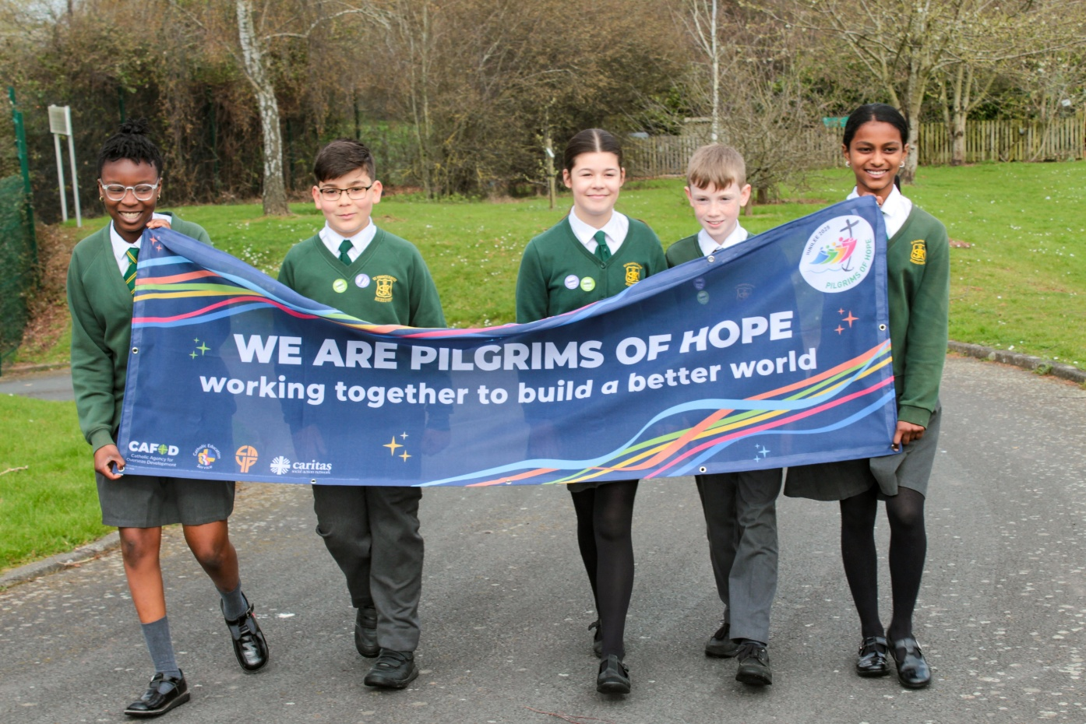

Slide 9
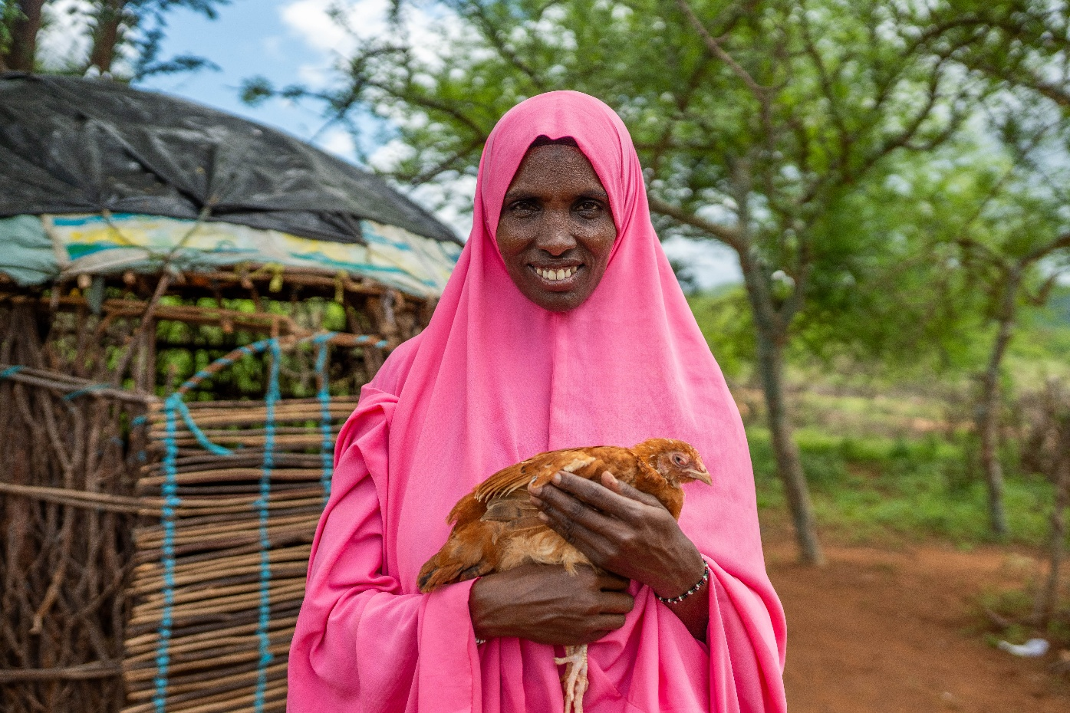

Slide 10
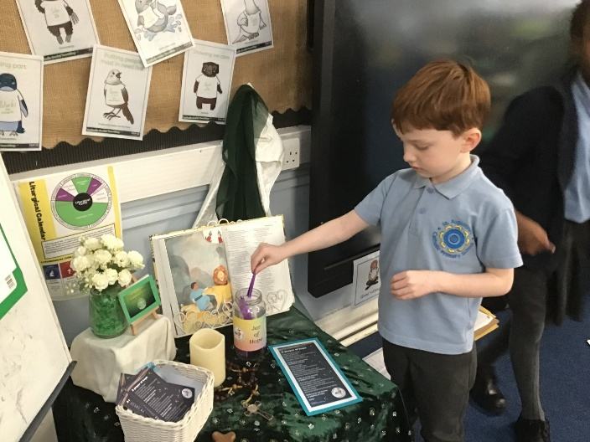
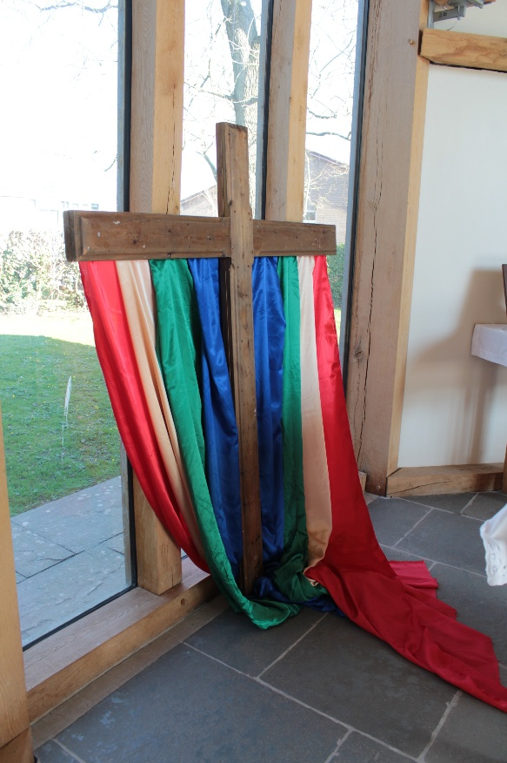
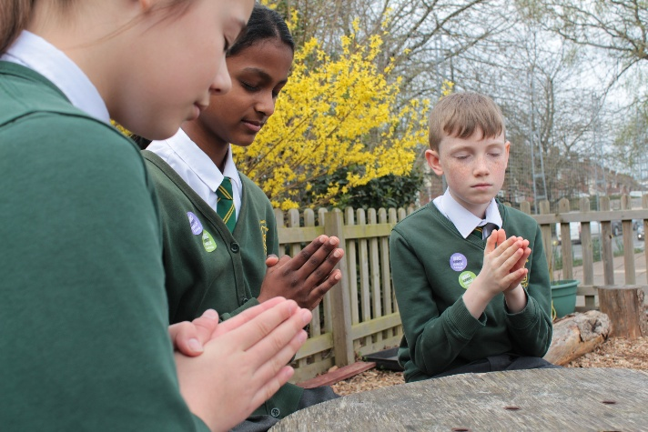

Slide 11
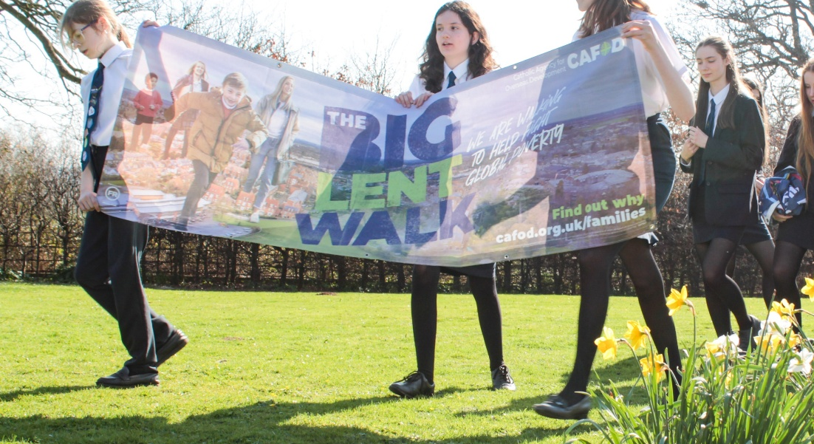
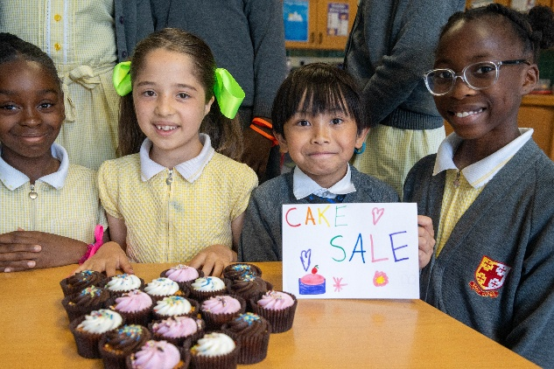

Slide 12
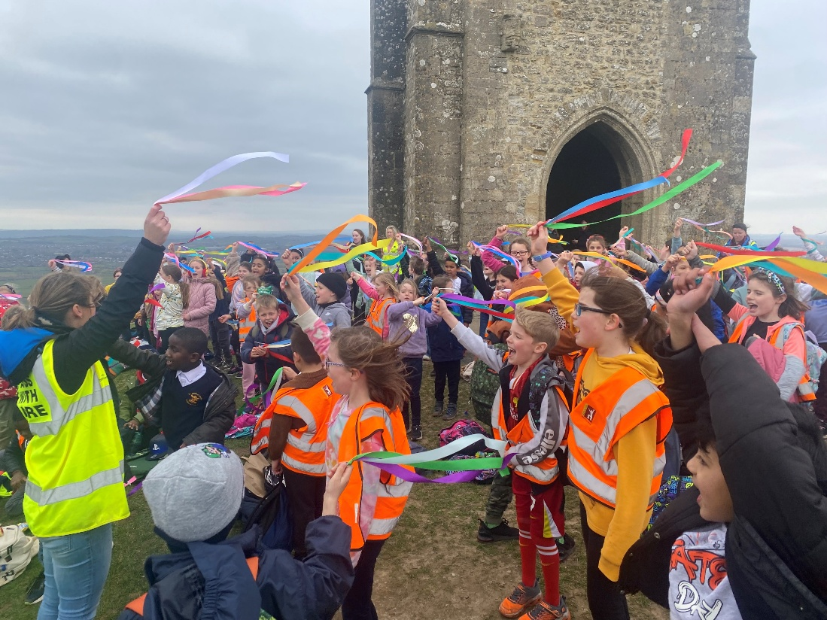
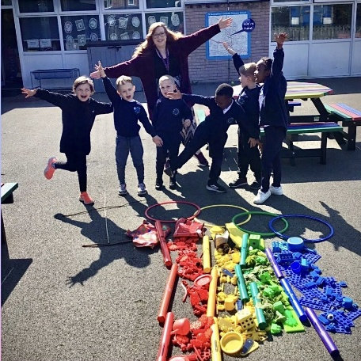

Slide 13
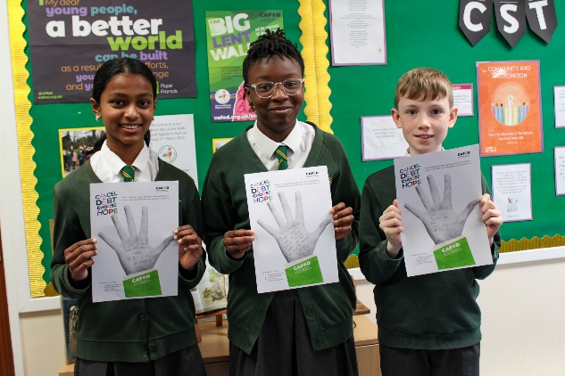
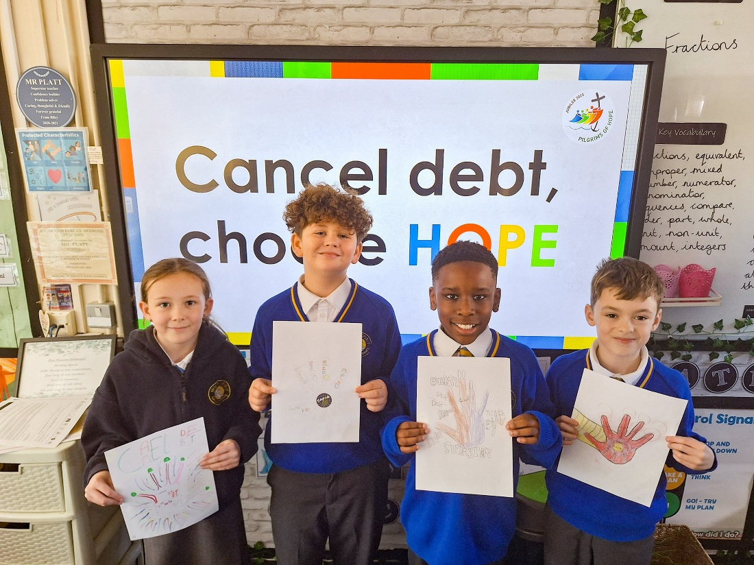
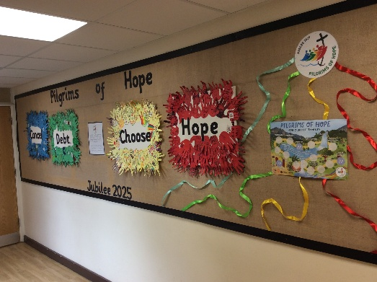

Slide 14


Send
‘We want to build a fairer world, where every person, and the earth, can flourish.’

Slide 15

How can we continue to live out our Jubilee Pledge with renewed hope?

Slide 16



Slide 17
Let us pray:
God, our loving Father,
In this Jubilee year,
you remind us of our
call to love creation.
Help us to work together to replant,
repair and renew.
All: Guide us on our journey as pilgrims of hope. Amen.

Slide 18
Let us pray:
Jesus, our light,
In this Jubilee year,
you remind us of our call to love
our neighbours and to set free those who suffer.
Help us to treat everyone with dignity;
to be fair, forgiving and kind.
All: Guide us on our journey as pilgrims of hope. Amen.

Slide 19
Let us pray:
Holy Spirit, our inspiration,
In this Jubilee year,
you remind us of our call to grow in
faith and love.
Help us to hear you in scripture, to see Jesus in others,
and to be united as God’s global family.
All: Guide us on our journey as pilgrims of hope. Amen.

Slide 20


